Slide 1
CRMLS Update Art Carter CEO, CRMLS

Slide 2
Our Vision
CRMLS is a Broker-Directed leader in the transformation of real estate data – supporting development of data sharing services, tools, and resources for the shared success of our Associations, Brokers and Agents

Slide 3
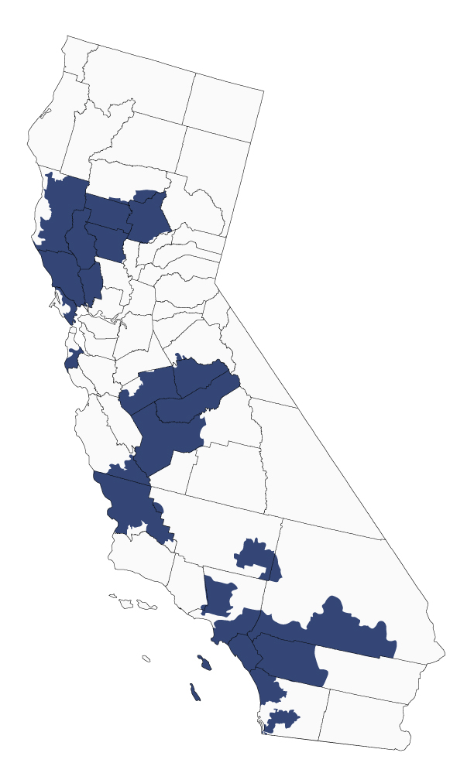
Arcadia | Mariposa County | Pasadena-Foothills
Burbank | Merced County | Pismo Coast
Citrus Valley | Montebello District | Rancho Southeast
Greater Downey | Newport Beach | San Luis Obispo
East Valley | North Bay* | Scenic Coast
Fresno | North San Diego | Sierra North Valley
Glendale | North San Luis Obispo | South Bay
Inglewood | Orange County | Southland Regional/CRISNet
Inland Valleys | Oroville | Southwest Riverside County
Joshua Tree | Pacific Southwest | The Inland Gateway
Laguna | Pacific West | Tri-Counties
Lake County | Palos Verdes Peninsula | West San Gabriel Valley
Madera | Paradise
38
THIRTY EIGHT
Participating AORs/BORs

Slide 4
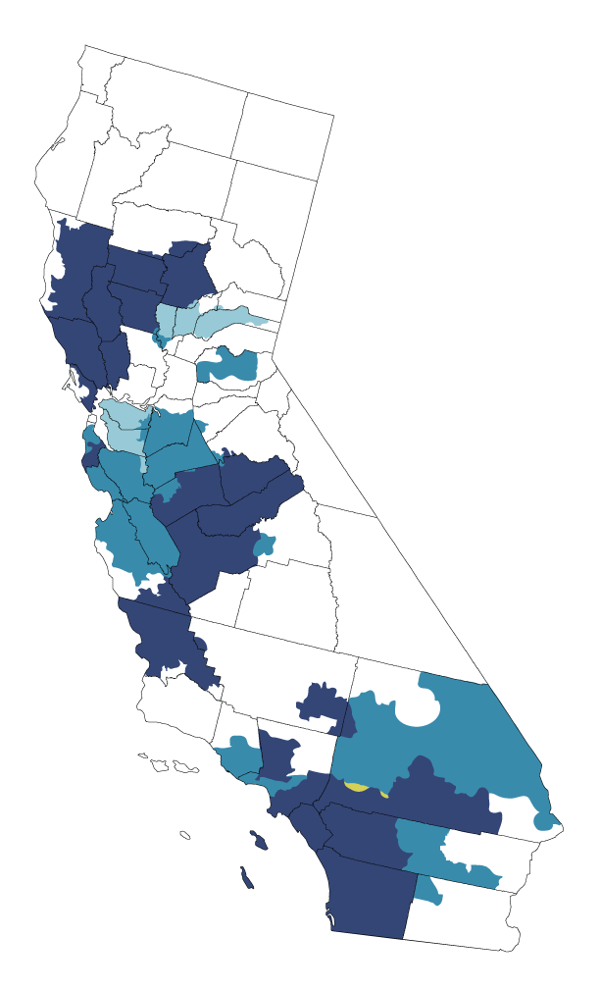
Data Shares: Agents access CRMLS listings directly from their MLS system. Data is exchanged frequently to keep listing information up-to-date.
17
Beverly Hills/Greater L.A. | Monterey County | Santa Clara
bridgeMLS* | Palm Springs Regional | Santa Cruz
California Desert | Pasadena-Foothills | Silicon Valley
Conejo Simi Moorpark | San Benito County | Southwest Los Angeles
High Desert MLS | San Diego | Ventura County Coastal
Malibu | San Mateo
SEVENTEEN
Data Shares
5
SIX
Reciprocal Access: Agents access data via login into a separate MLS system.
Reciprocal
Alameda | Contra Costa | Sutter-Yuba
Bay East | Honolulu

Slide 5
CRMLS Advantages
We offer our users state-of-the-art MLS technology to help their business grow, helpful training on MLS products, and personal support 7 days a week.

Slide 6
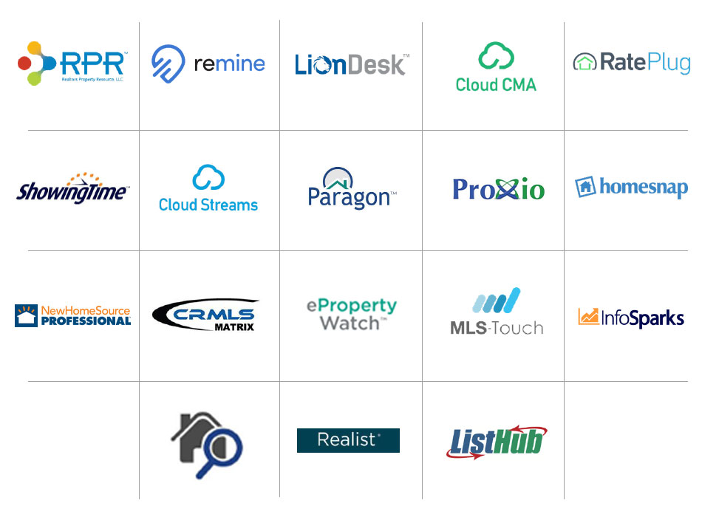
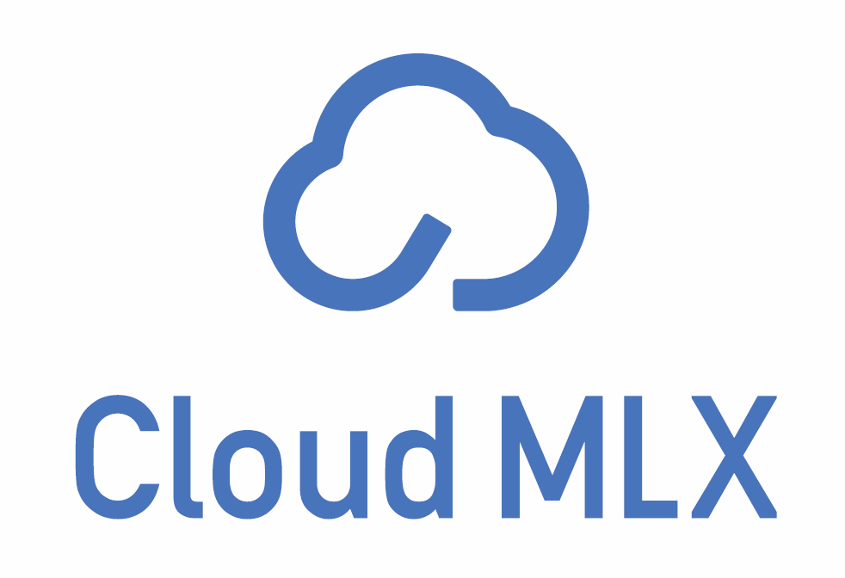
18
EIGHTEEN
Products at no additional cost

Slide 7
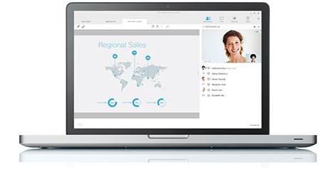
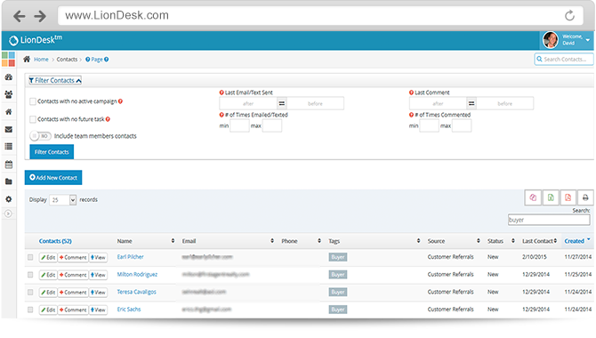
Manage contacts and automate follow-up
Collect, route and follow up on leads Serves as integration hub for products like Cloud CMA, ShowingTime, and Remine
Automate follow-up reminders or send direct communications
to contacts

Slide 8
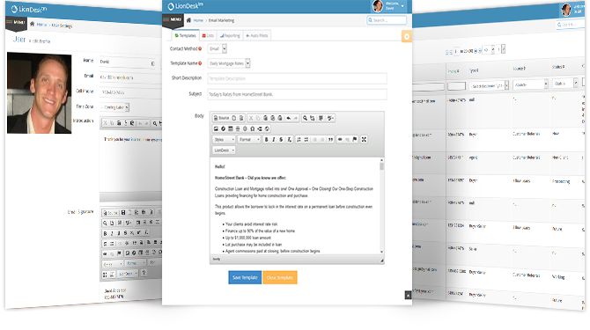
With the Teams feature, you can assign leads and contacts to other team members and distribute to them based on performance.

Slide 9
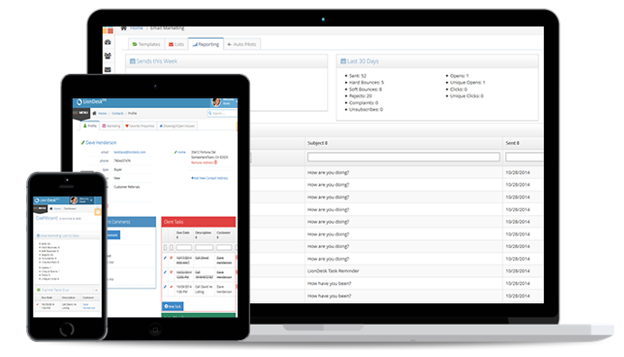
Document Management Upload your legal documents, client presentations and more to LionDesk by email or upload.

Slide 10
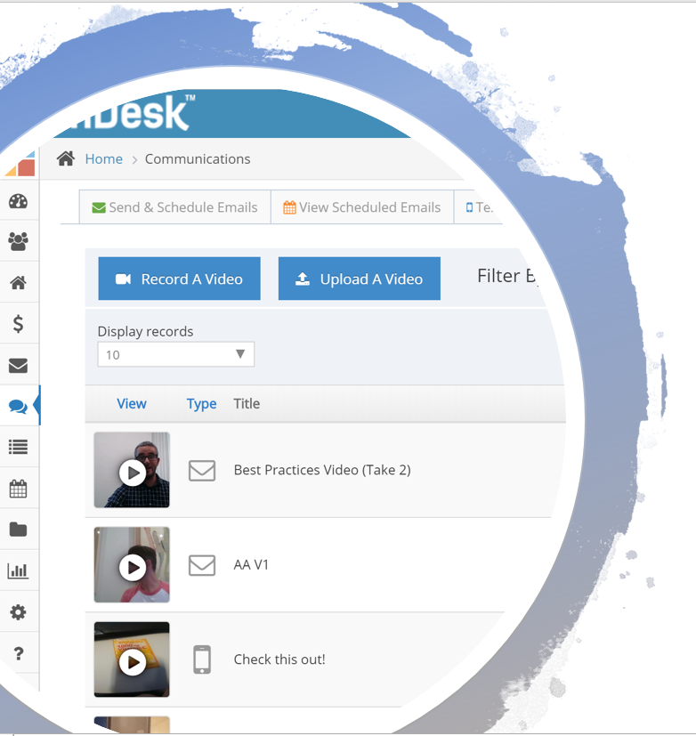
Video Technology
Create and send video emails directly from LionDesk, or the LionDesk app.
New listing? Record a video, and send it to 5, 50, or 500 of your clients to show them the listing before anyone else see’s it!

Slide 11
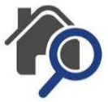
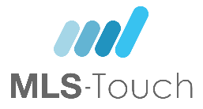
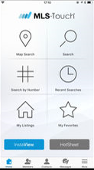
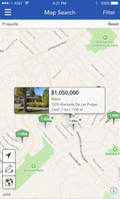
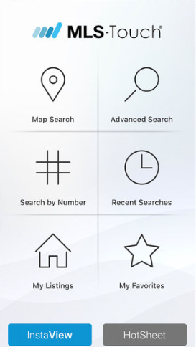
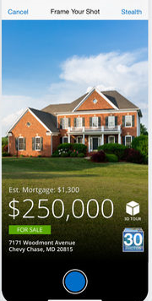
CRMLS App
HomeSpotter™ tool
Walk score and commute time
CRMLS Matrix portal carts & favorites
Rapid CMA generator
Your listing, your lead: fair display guidelines from the Broker Public Portal
InstaView Tool
Pull up live market statistics on-the-go
Search for comparables

Slide 12
TIGAR Co-Op Products
Glide and SavvyCard

Slide 13
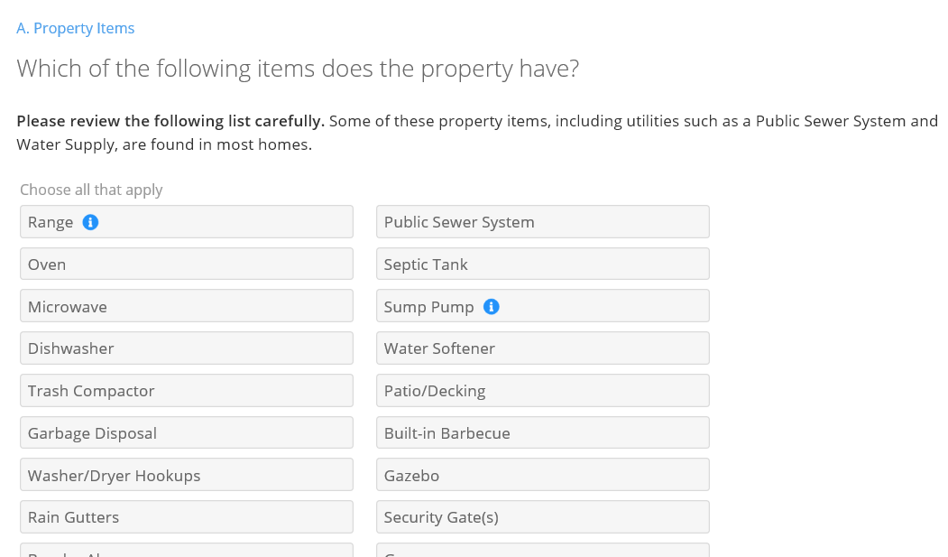
No missed questions, no bad handwriting, complete audit trail
It’s like “TurboTax” for real estate forms
Integrated with zipForm Plus – sync documents seamlessly

Slide 14
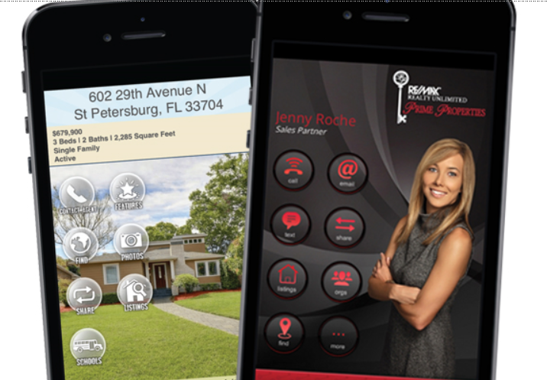
A SavvyCard is a Progressive Web Application (PWA) that loads in a browser and does not require passwords, downloads, installs, or updates to use.
Lead Development Platform
Generate leads through your sphere of influence and social media.

Slide 15
Training
In-person classes
Live and recorded webinars
Quick how-to videos
Robust knowledgebase library
See your options on crmls.org/education

Slide 16
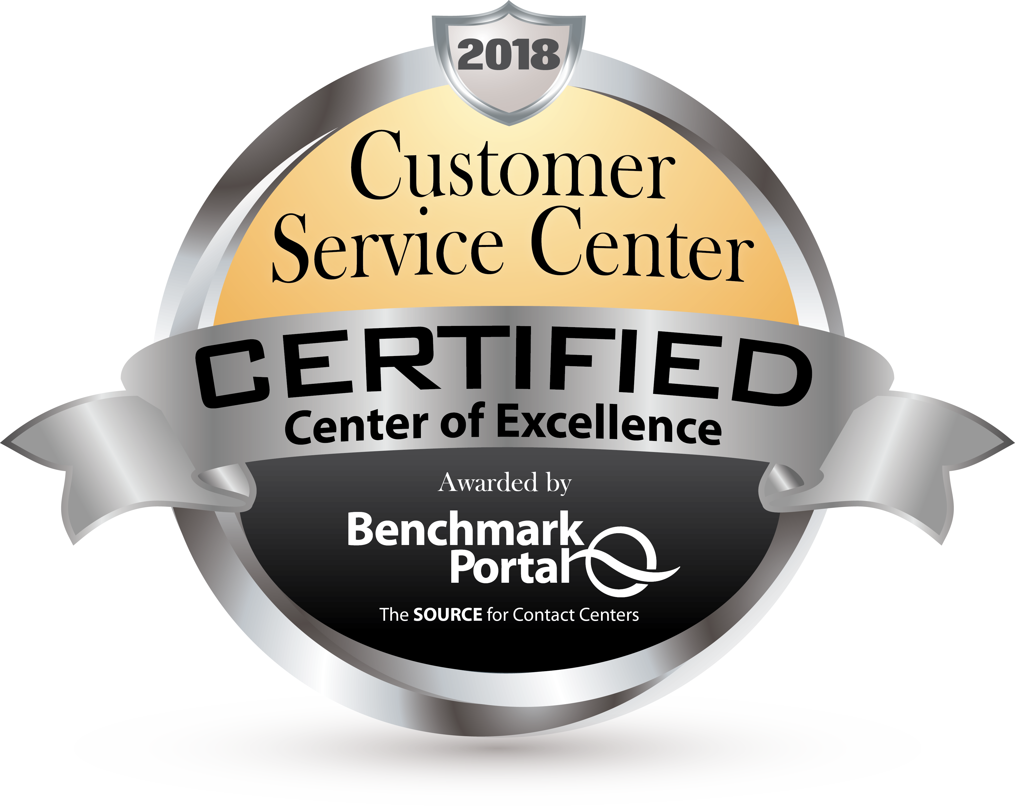
Support
Certified as a Center of Excellence by
BenchmarkPortal
Phone
Live chat
Submit a ticket
7 Days/Week
Mon. – Fri. (8:30 am – 9 pm) Sat. – Sun. (10 am – 3 pm)
crmls.org/support

Slide 17
Compliance
Clean data matters.
We keep the playing field level.
Online resources include:
FAQs, forms, Rules & Policies & more
Working hard to keep listing data accurate crmls.org/compliance

Slide 18
Broker Resources
CRMLS is broker-driven. We work to keep our brokers as informed and up-to-speed as possible.
Broker Resources will help you and your staff assist your agents in their day-to-day business.
crmls.org/brokers

Slide 19
Broker Resources
CRMLS shares data syndication revenue with syndicating brokerages for third straight year
Approximately 2,400 brokerages that participate in data syndication and contributed 10 or more listings to the CRMLS database between April 1, 2018 and March 31, 2019 received checks.

Slide 20
Using Photographs in the MLS

Slide 21
CRMLS Photographer List
Central benefit for listing agents
Limit confusion about copyright and licensing: participating photographers agree to give users the licensing rights they need
Central benefit for photographers
Increased marketing reach: display on CRMLS.org; presence in CRMLS marketing for those who sign up
Qualified photographers may gain limited Matrix access crmls.org/photographer-list

Slide 22
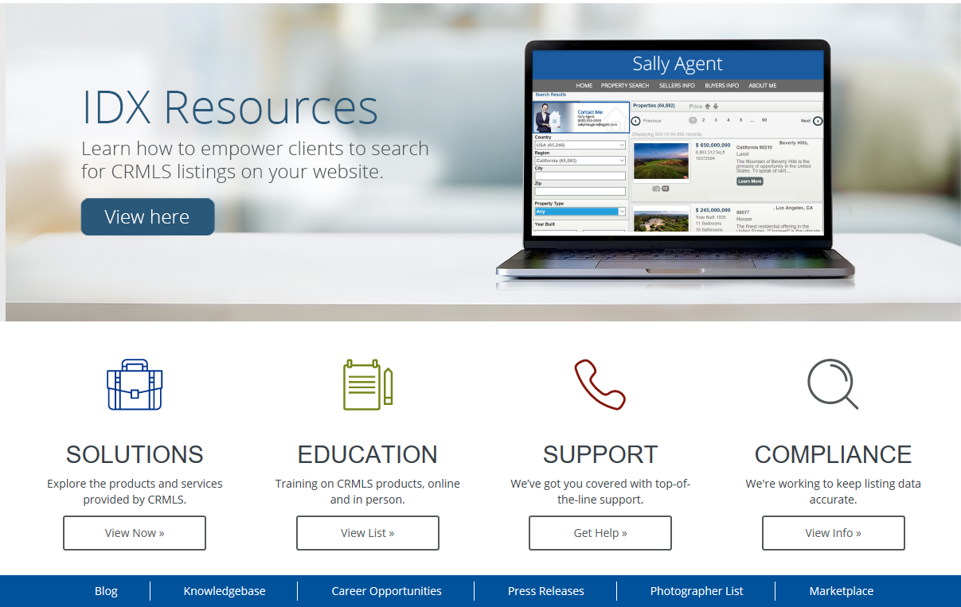
CRMLS Photographer List
Qualified photographers may gain limited Matrix access crmls.org/photographer-list

Slide 23
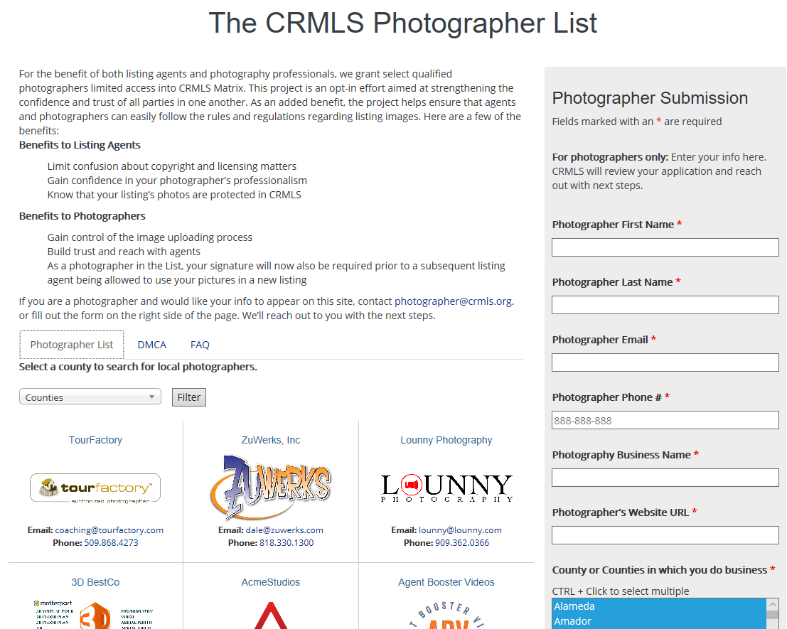
The Photographer List So Far
Over 120 photographers have been approved
Logo, contact info, & site links for program participants available on CRMLS.org
By-county search function & filtering for users

Slide 24
iBuyers
What are they and what does it mean for your business?

Slide 25
What is an iBuyer?
iBuyers represent one of the most revolutionary changes to occur in real estate. They aim to transform how consumers buy and sell houses – shaking up a large industry.

Slide 26
What is an iBuyer?
A company that makes quick cash offers on real estate
Distinct from “flippers” in business model, technology
Growing rapidly, especially in the South and West

Slide 27
The iBuyer Model
Use emerging technology to price, show, and sell homes
Focus on homes that need little renovation
Deliver profit based on high volume, not high margin per unit

Slide 28
What do iBuyers Mean for Your Business?
Could this be “real estate’s cord-cutter moment”?
Will consumers buy and sell most homes from companies?
Is “iBuying” a startup craze, or here to stay?
Is this good or bad for agents?

Slide 29
ANY QUESTIONS?

