Slide 1
Welcome to the Thursday Breakfast Meeting
May 9, 2019
Breakfast Provider:
Greeters:

Slide 2
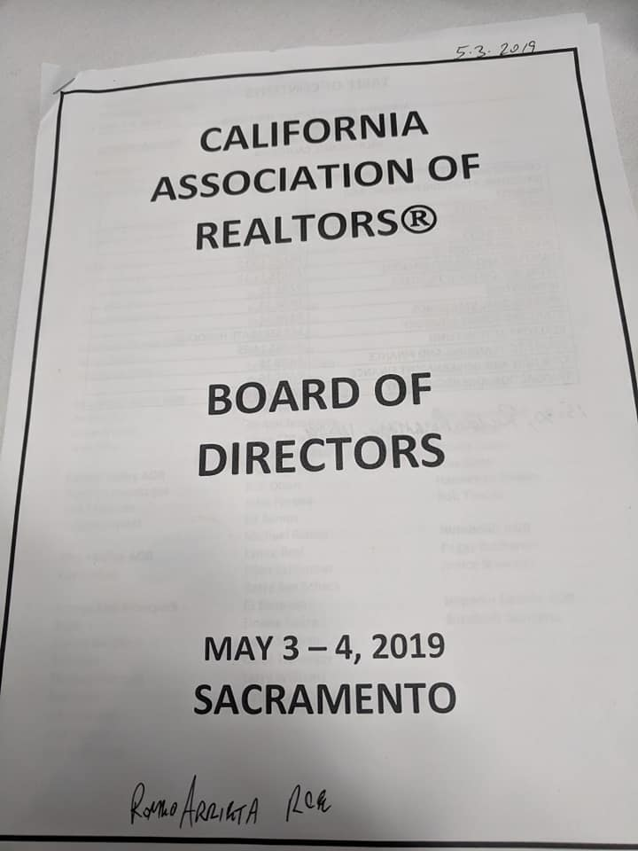
CAR Legislative Day & Business Meetings

Slide 3
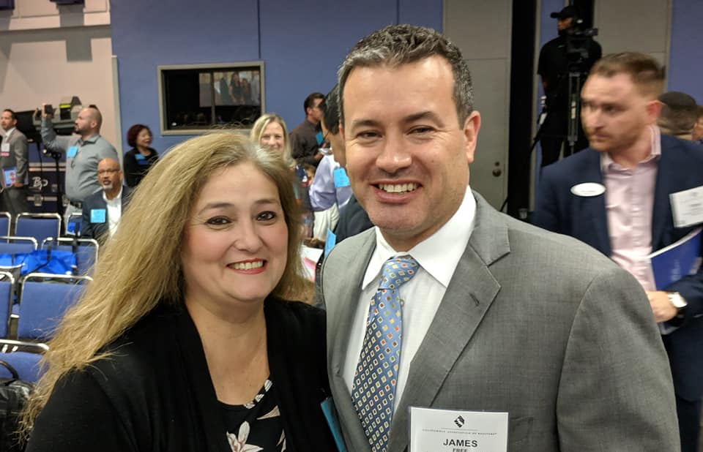
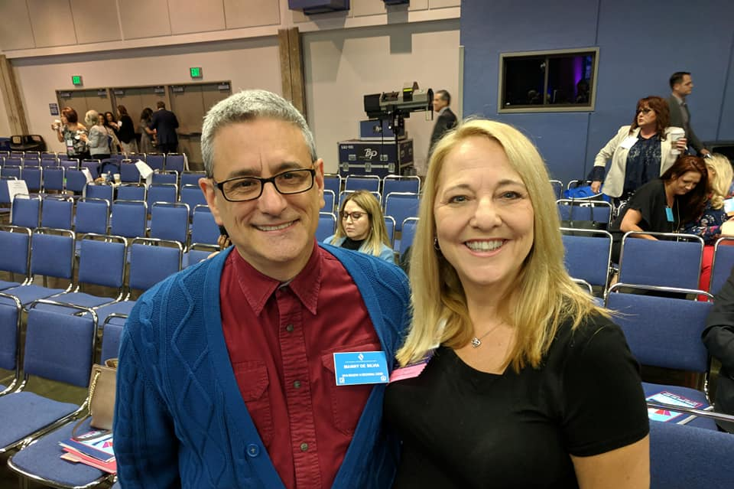
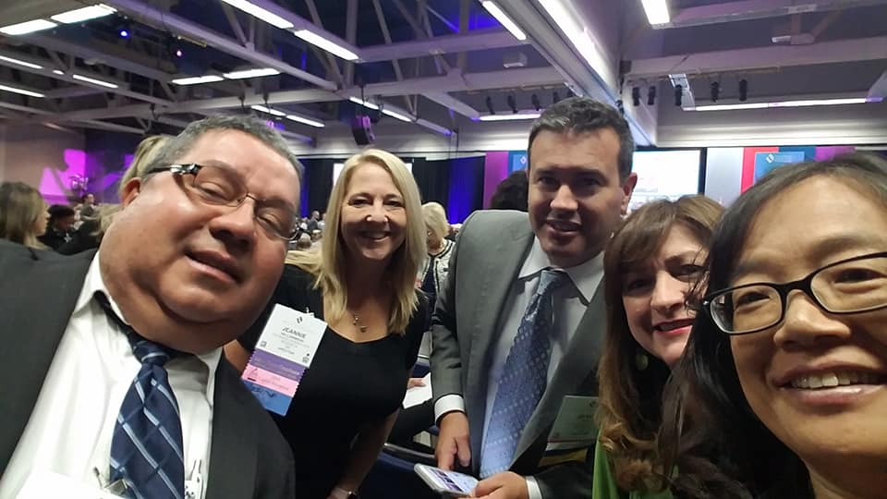
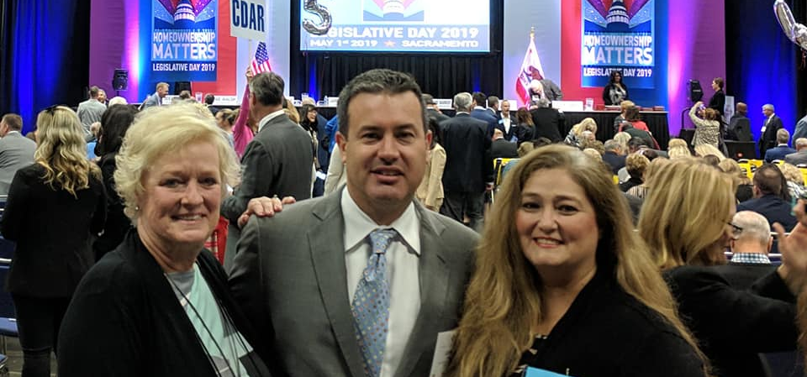

Slide 4
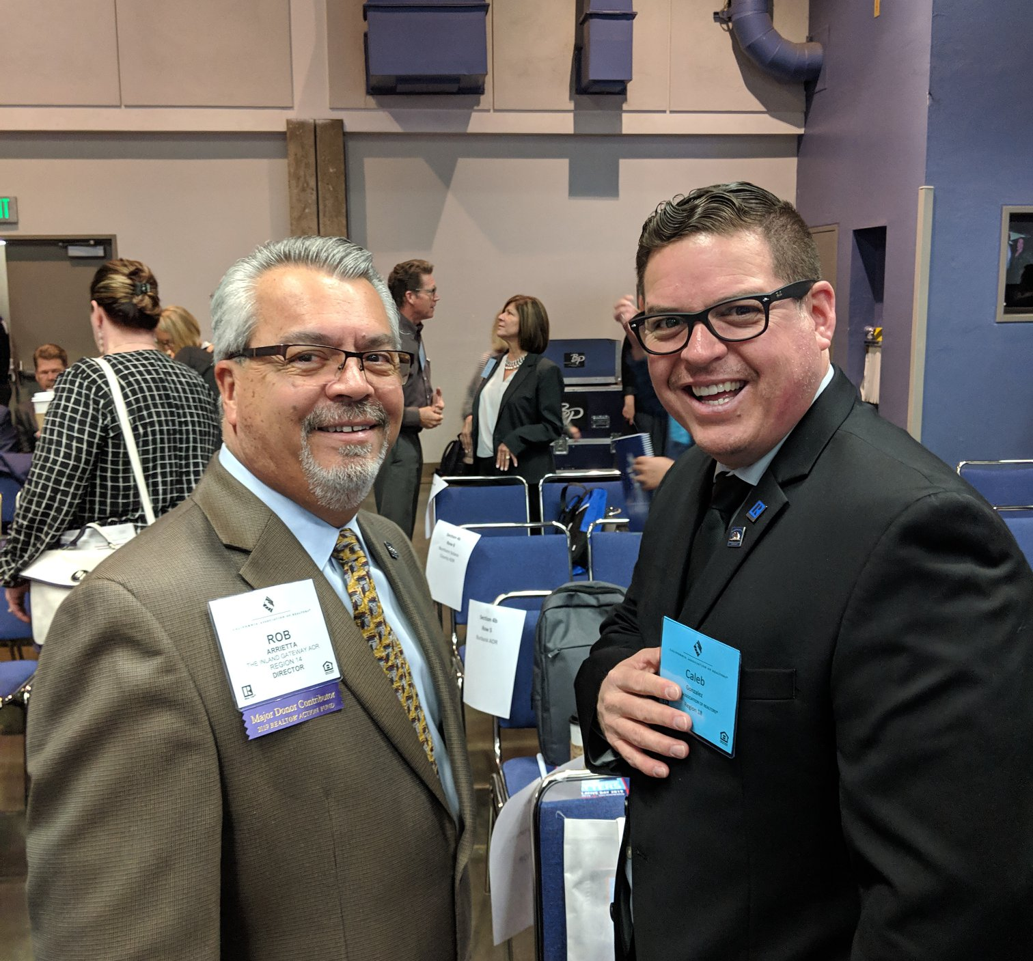
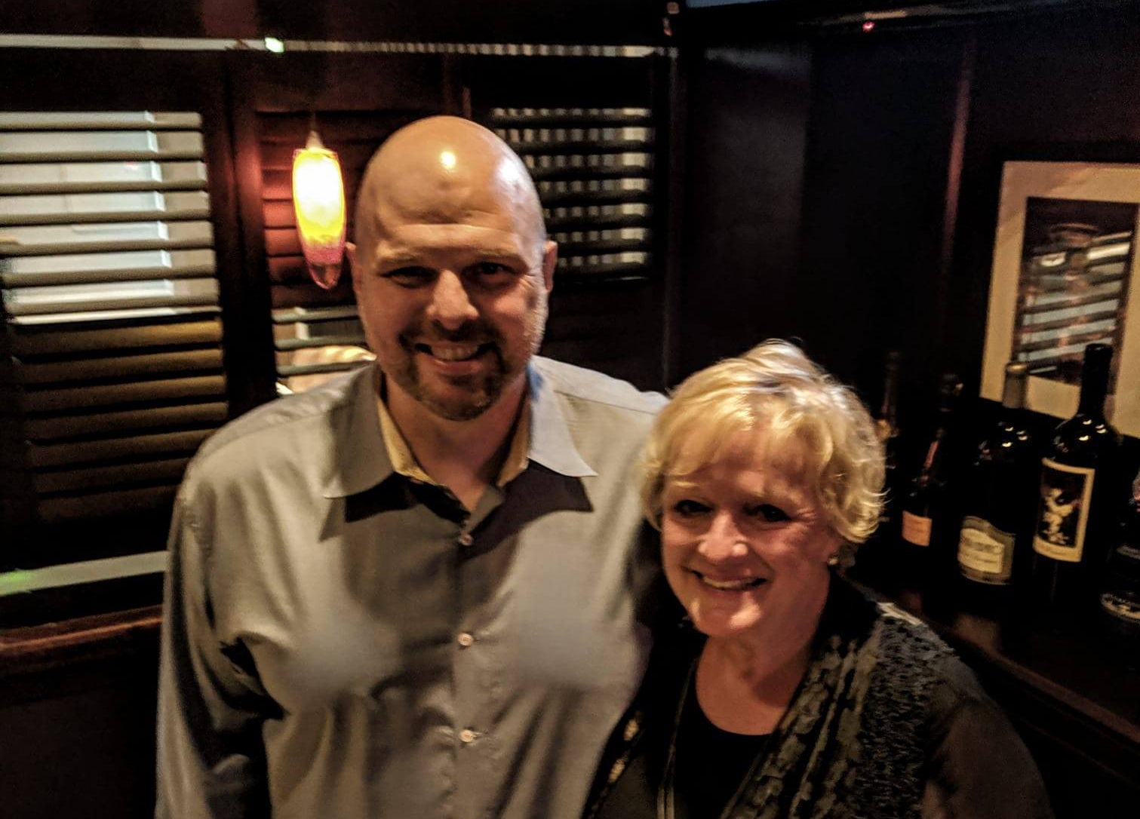
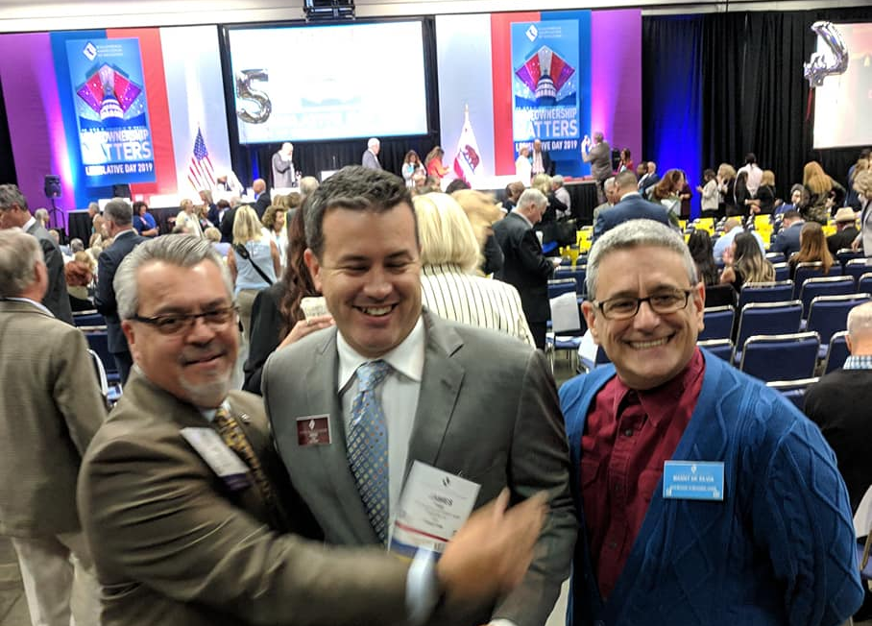

Slide 5
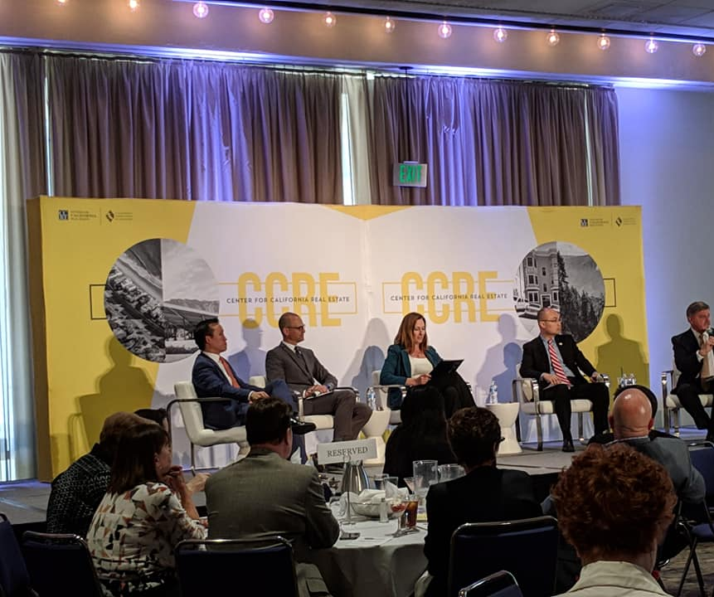

Slide 6
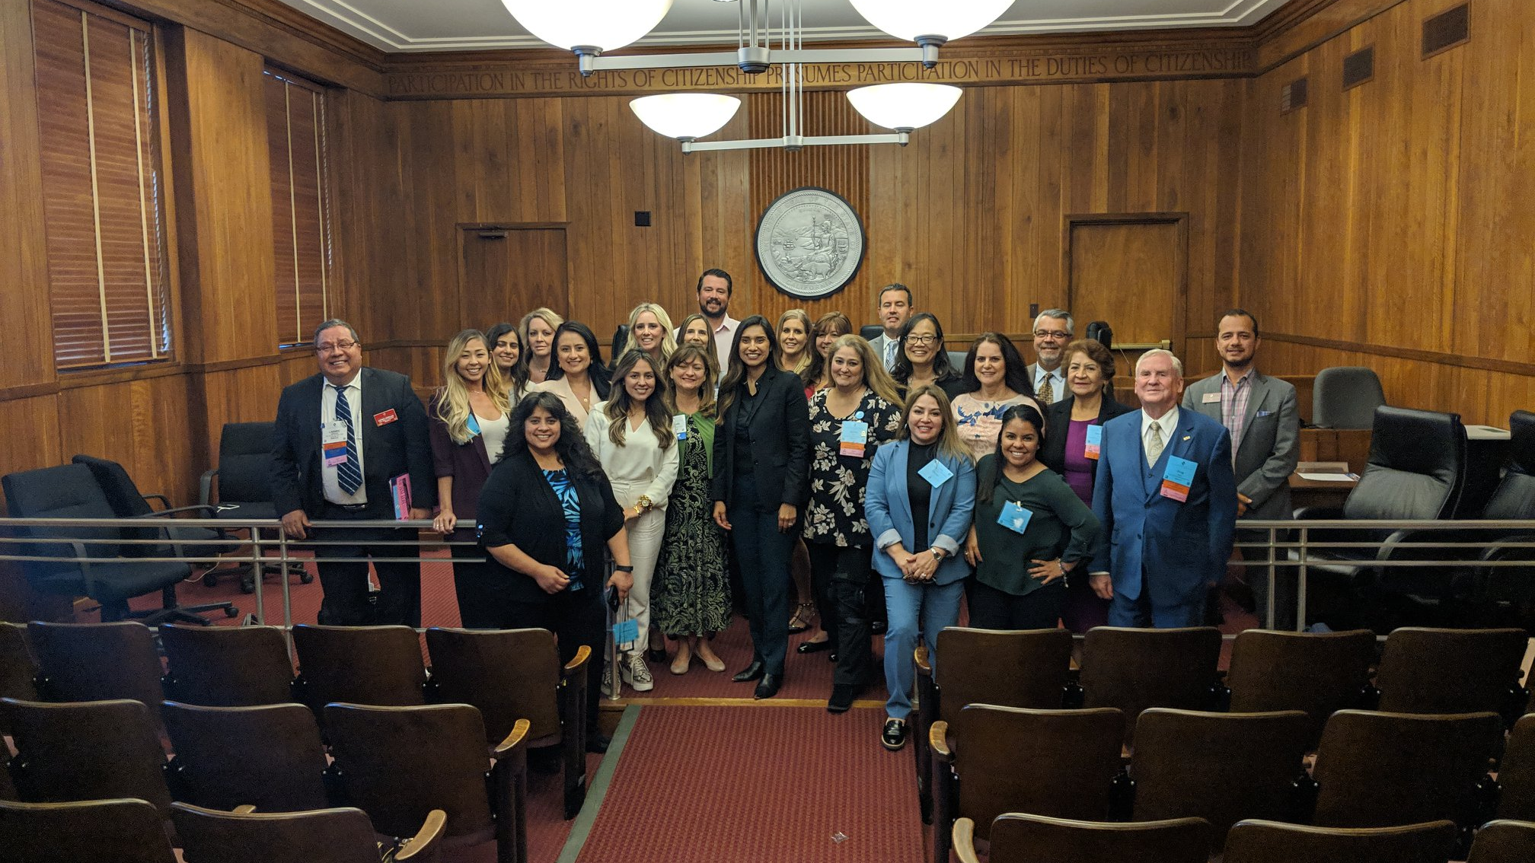

Slide 7
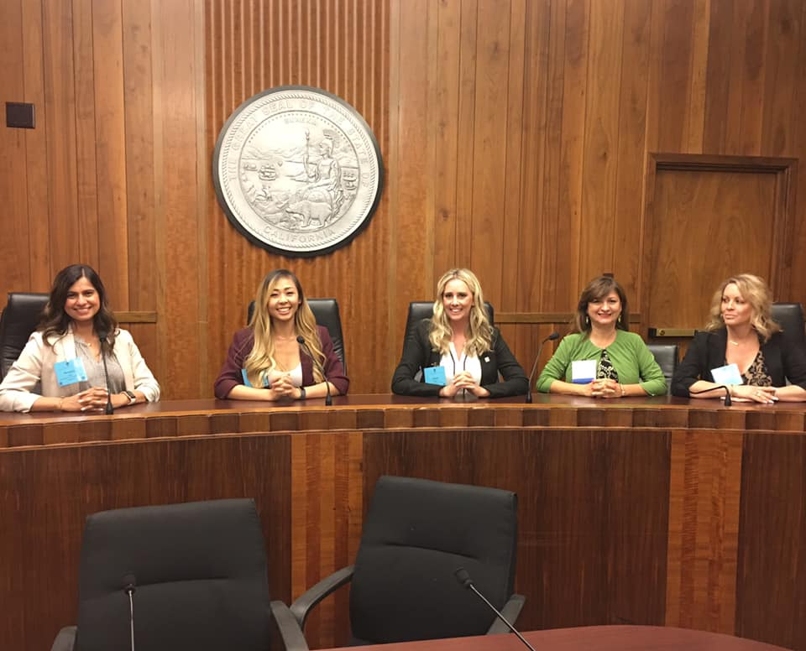
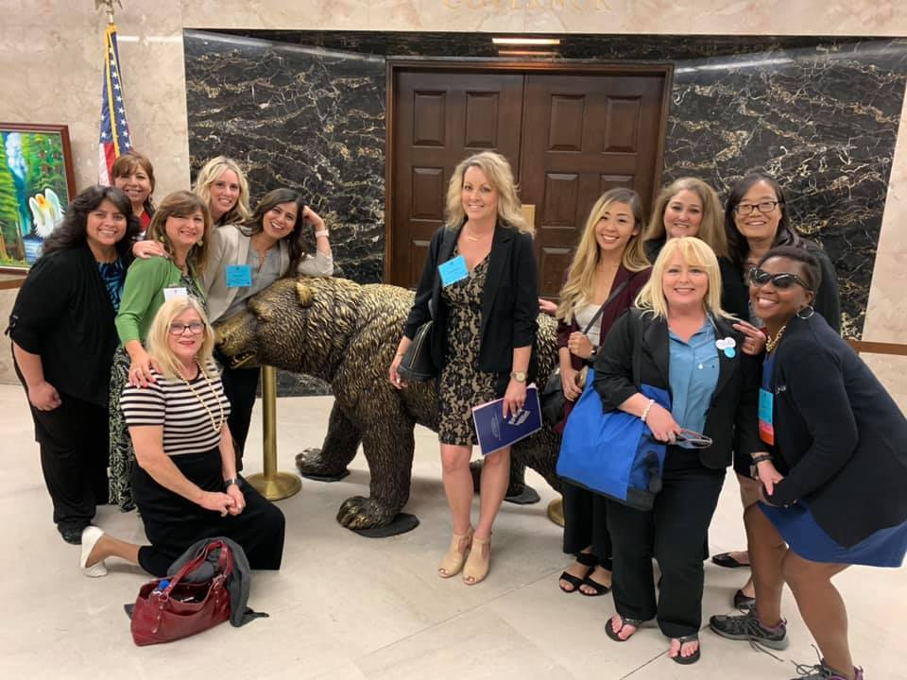

Slide 8
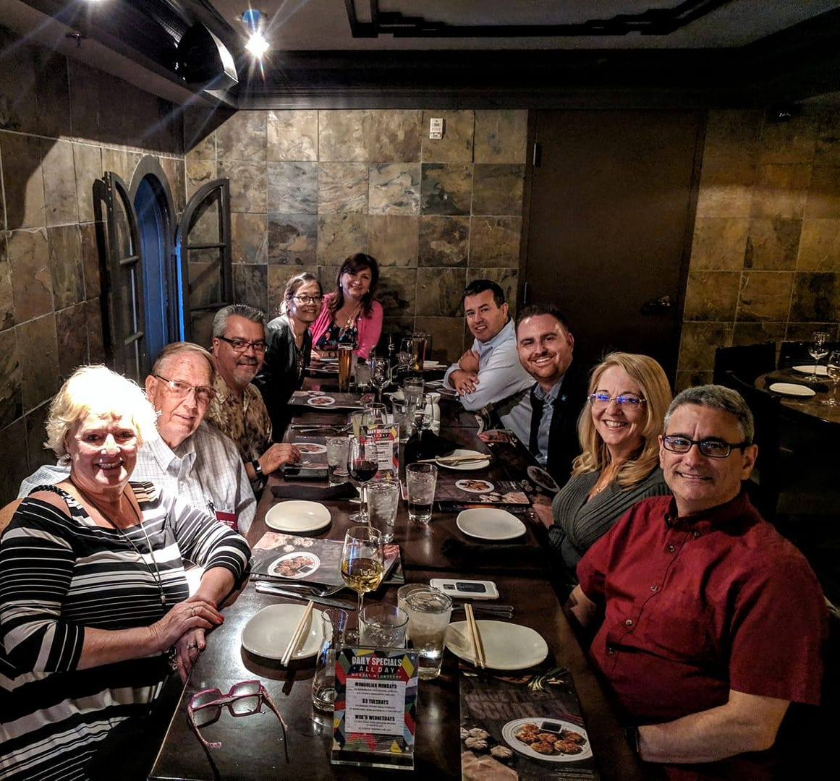
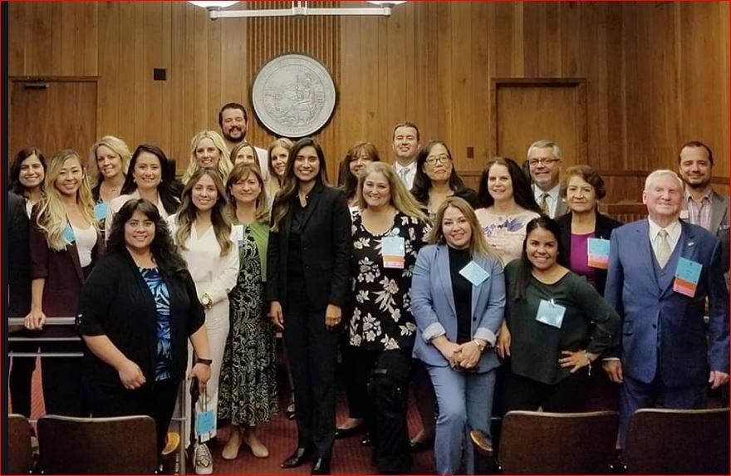
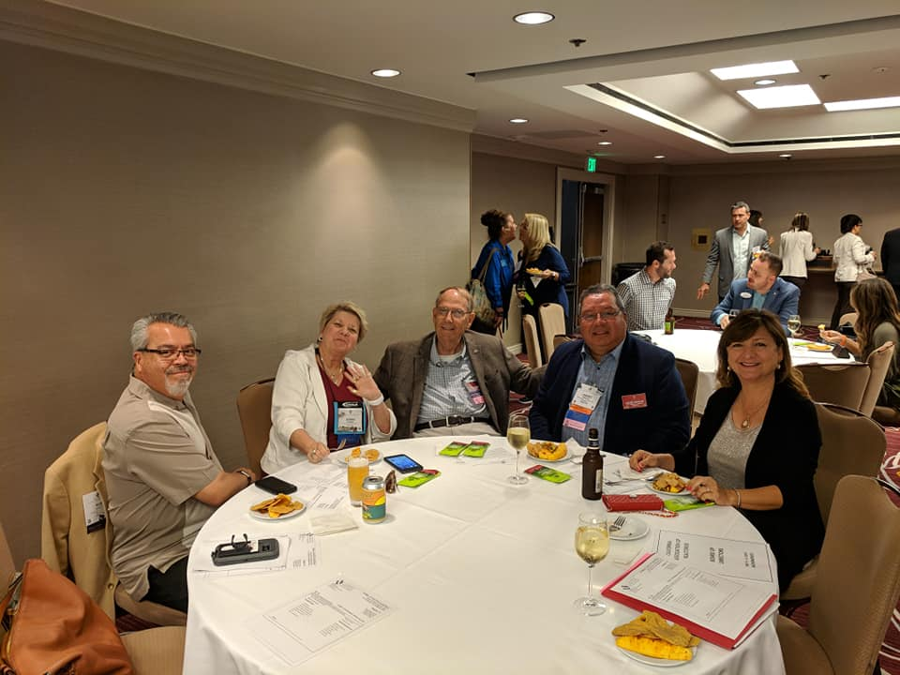

Slide 9
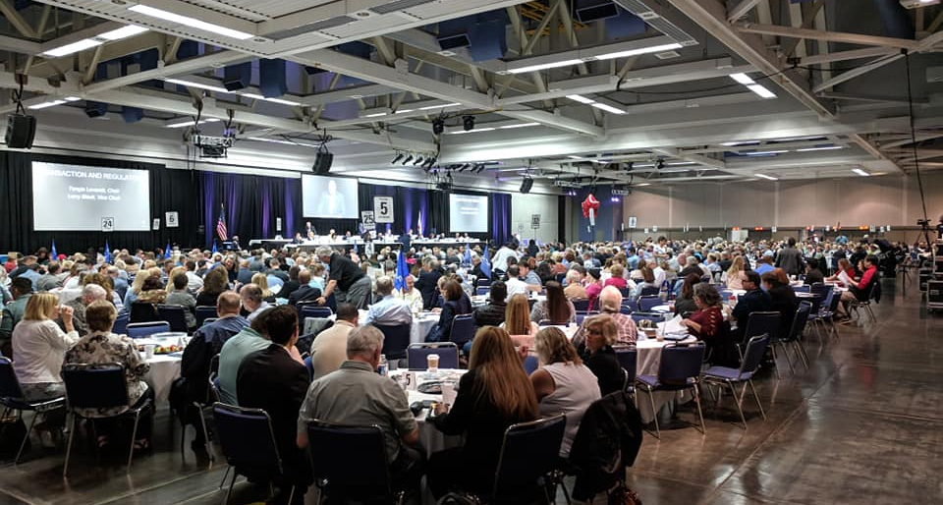
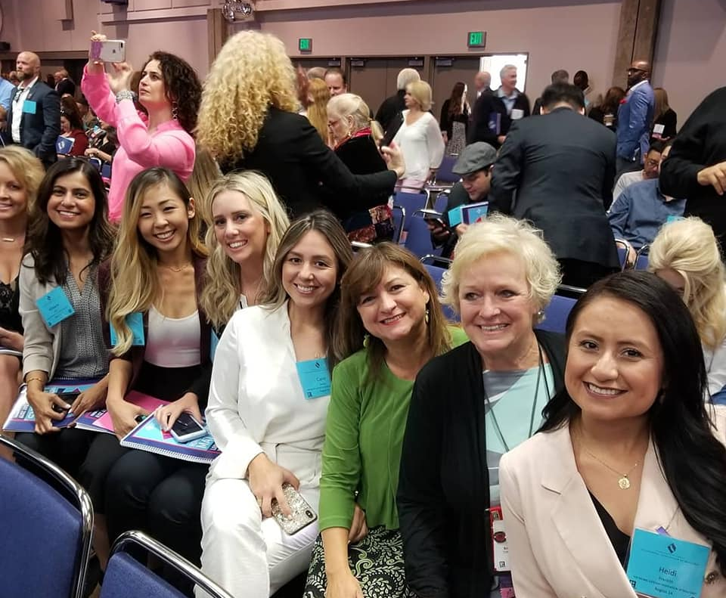
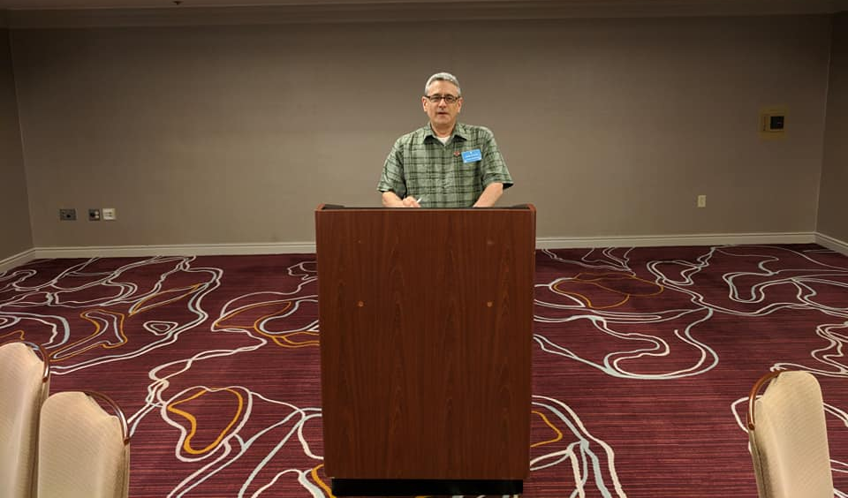
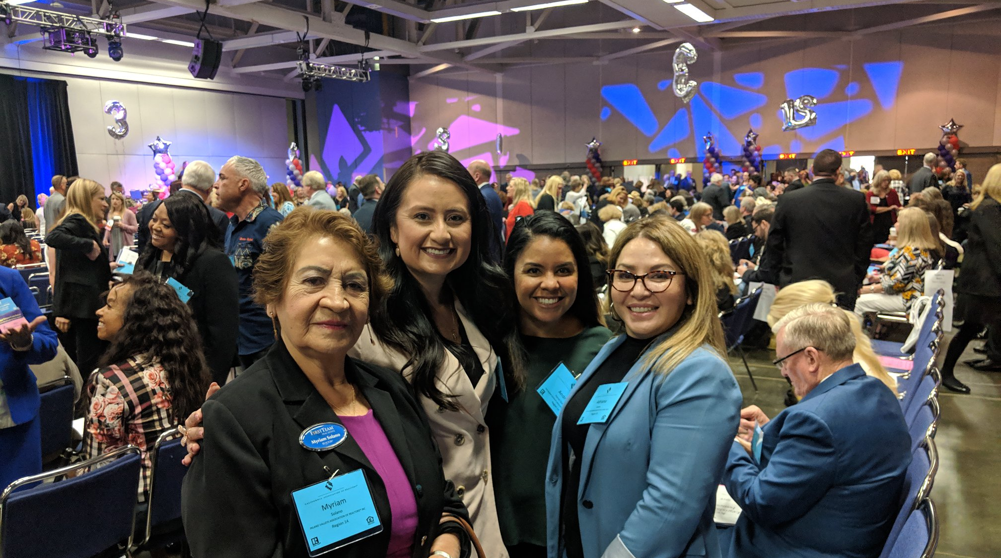

Slide 10
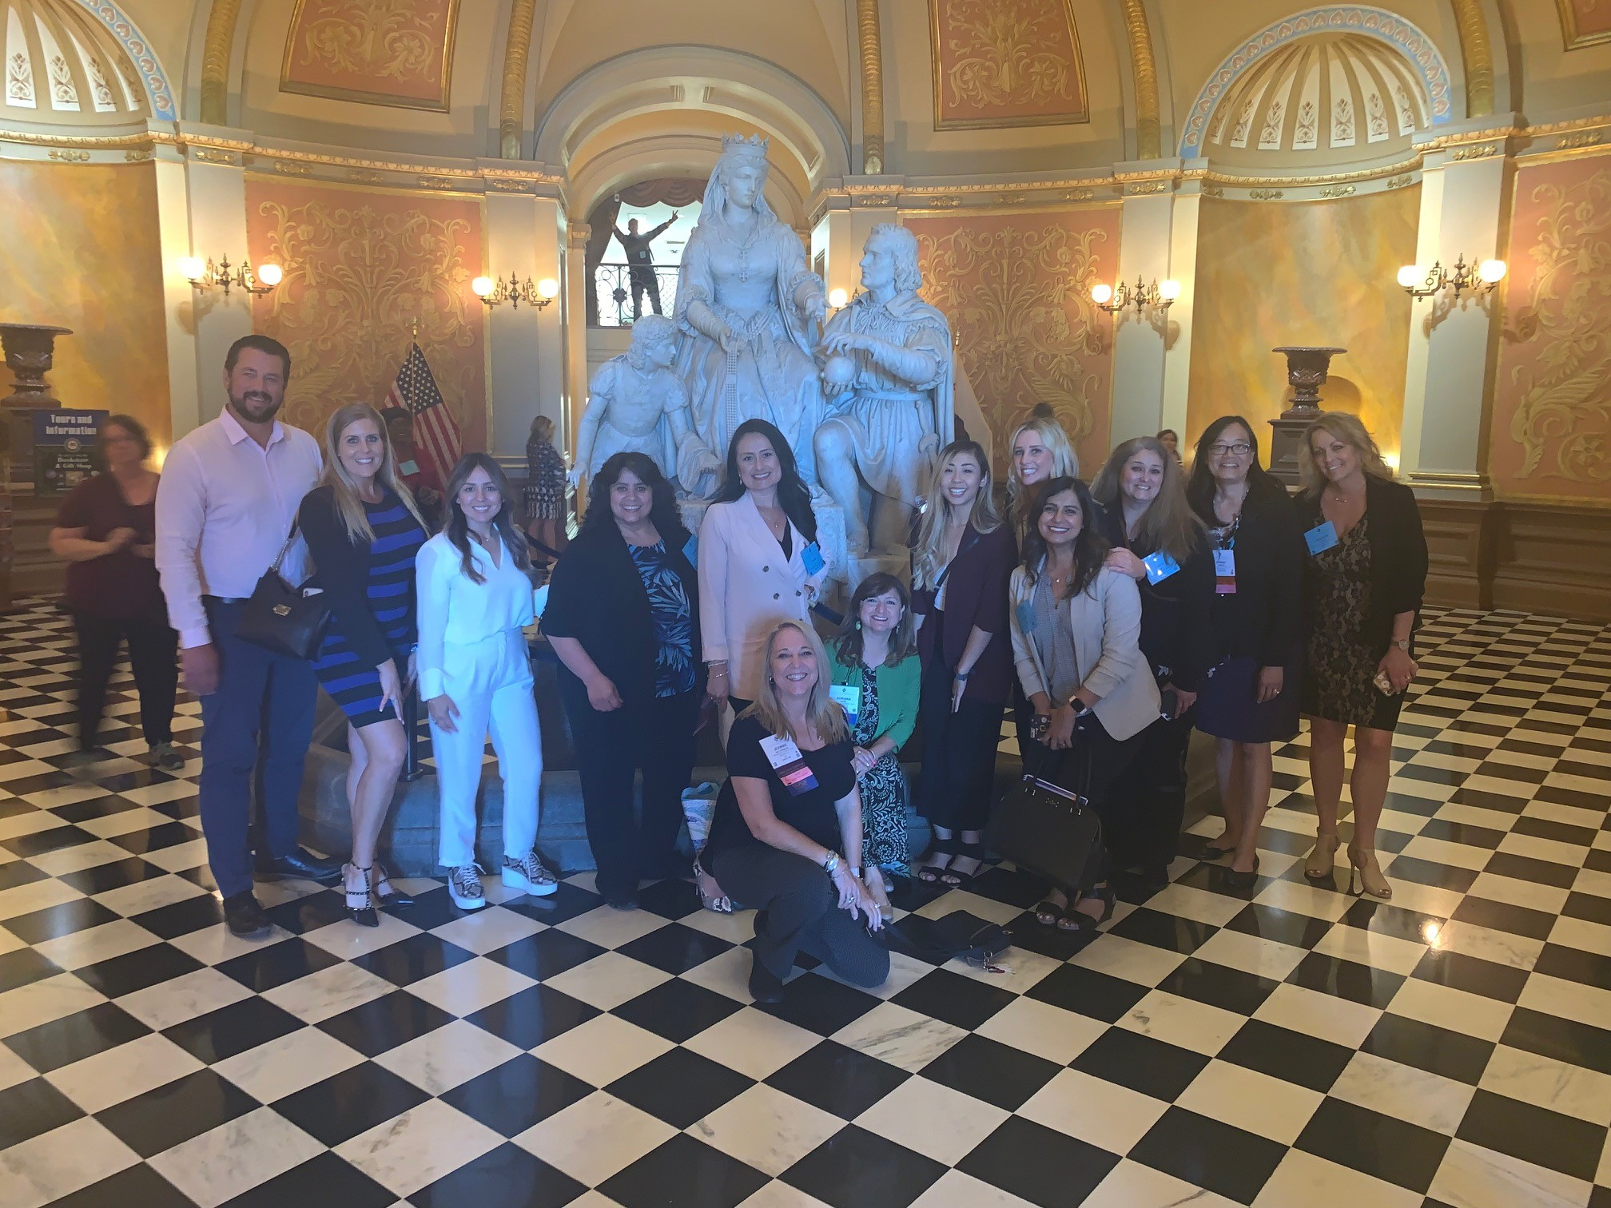

Slide 11
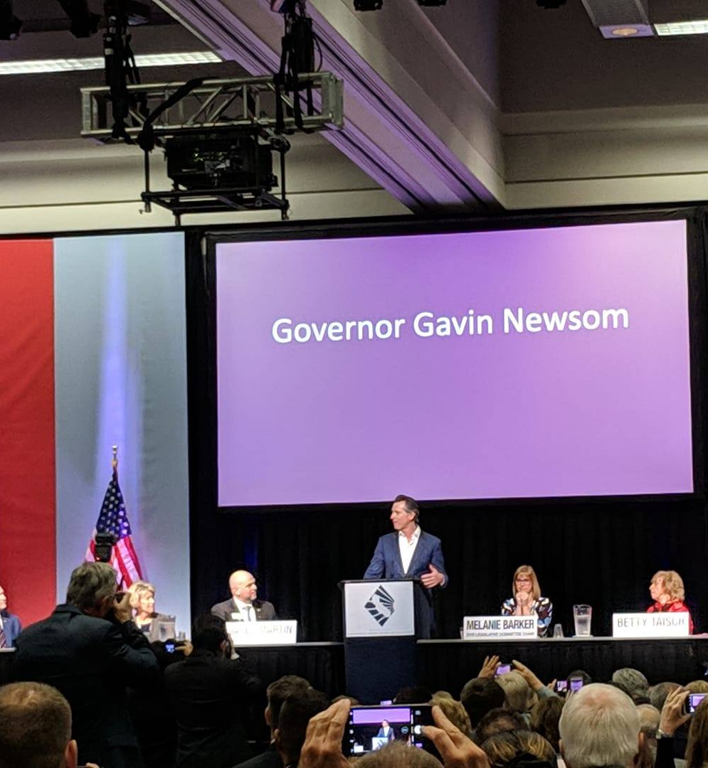

Slide 12
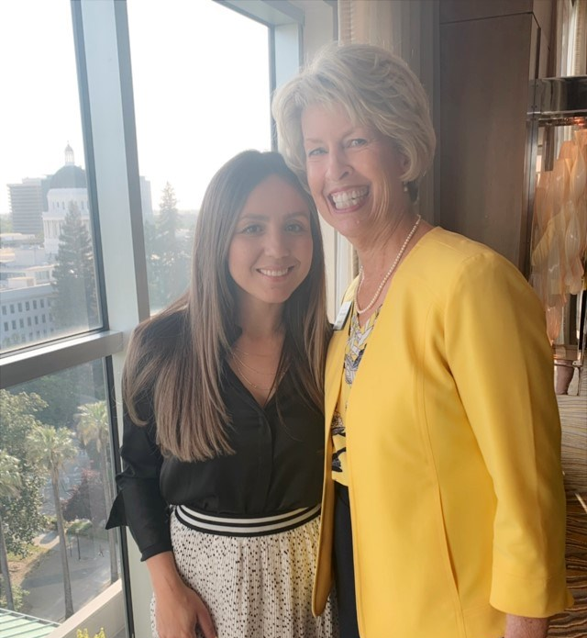
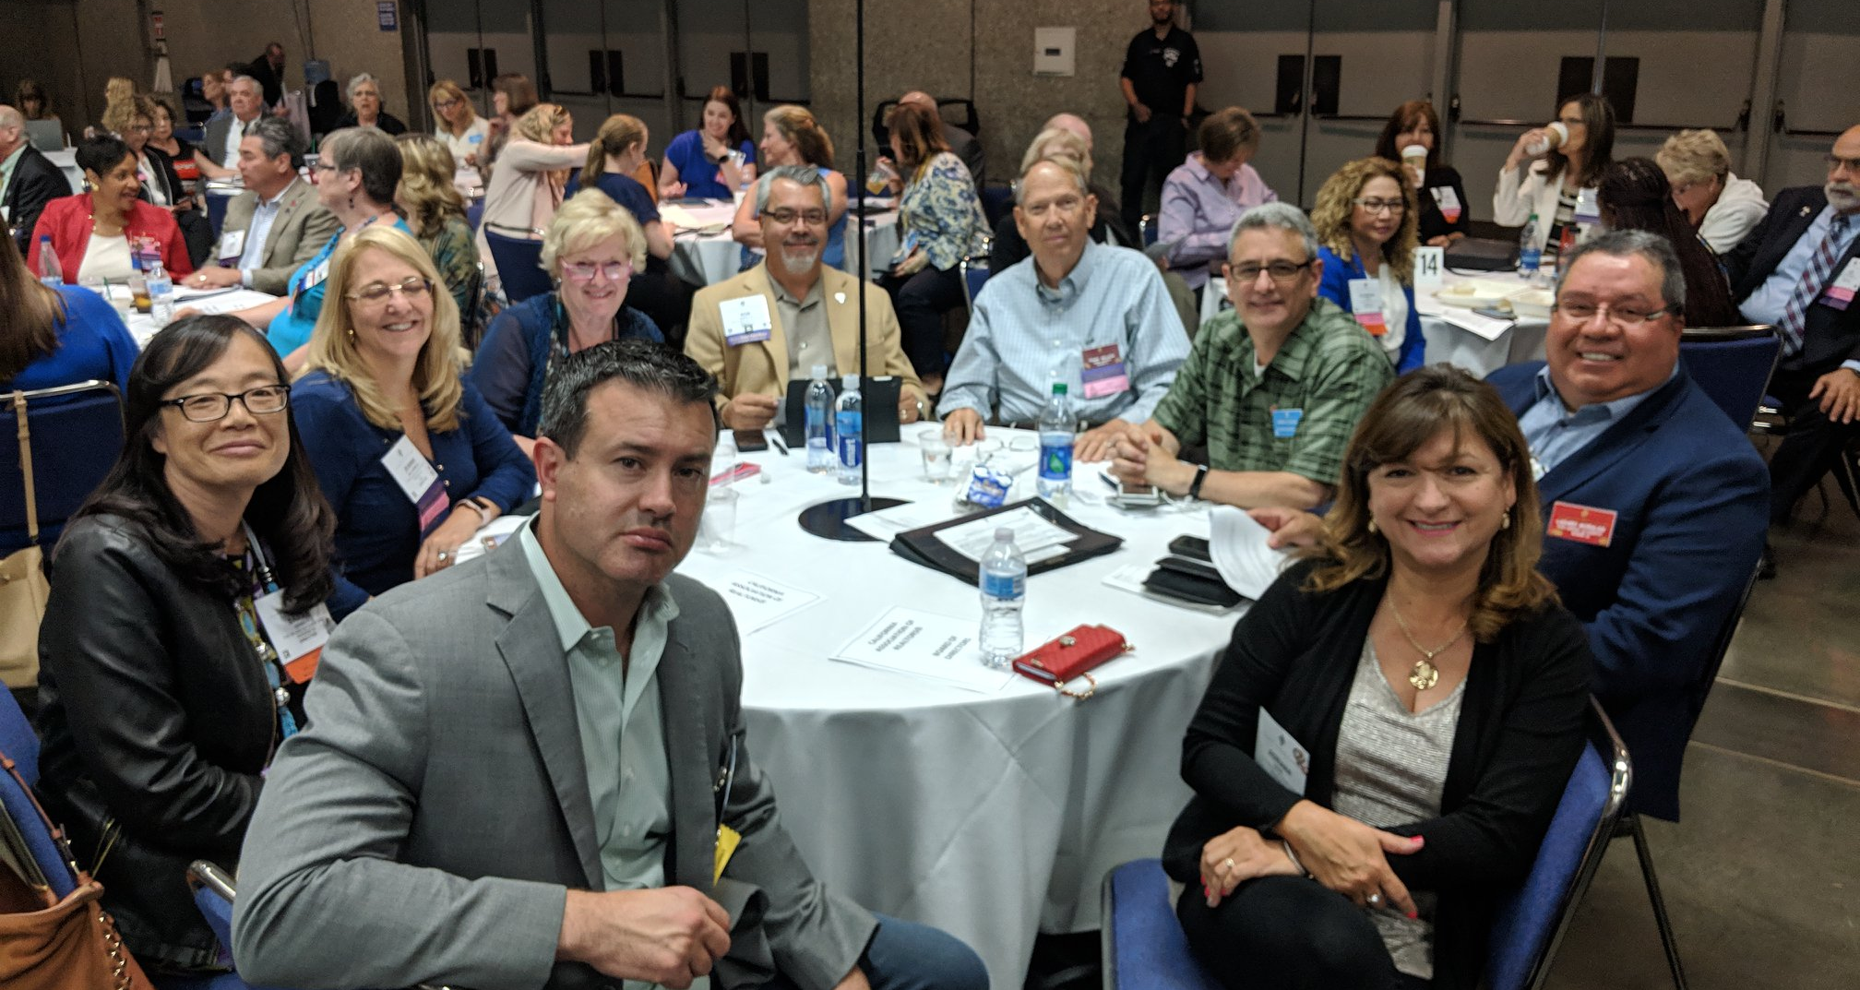

Slide 13
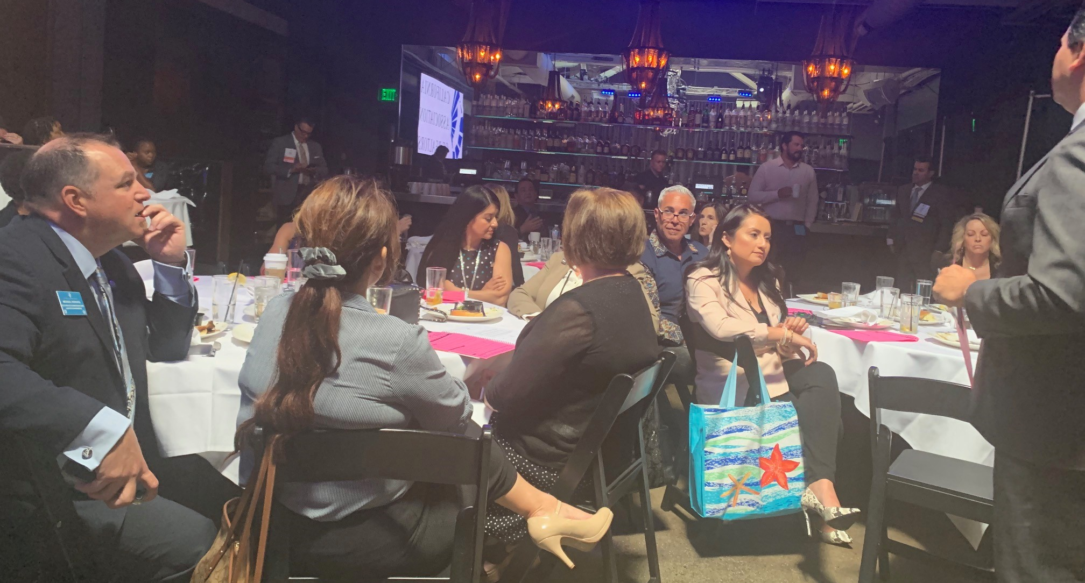
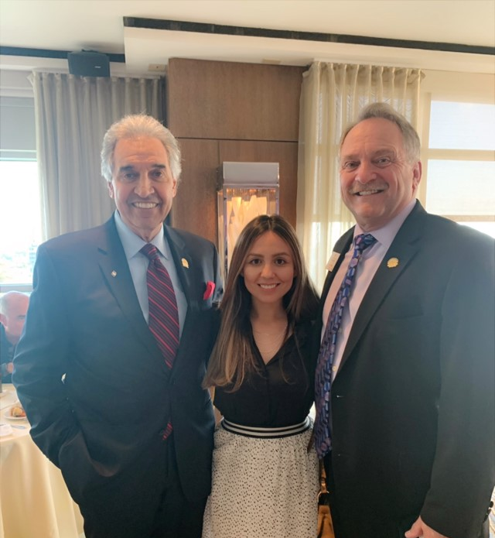
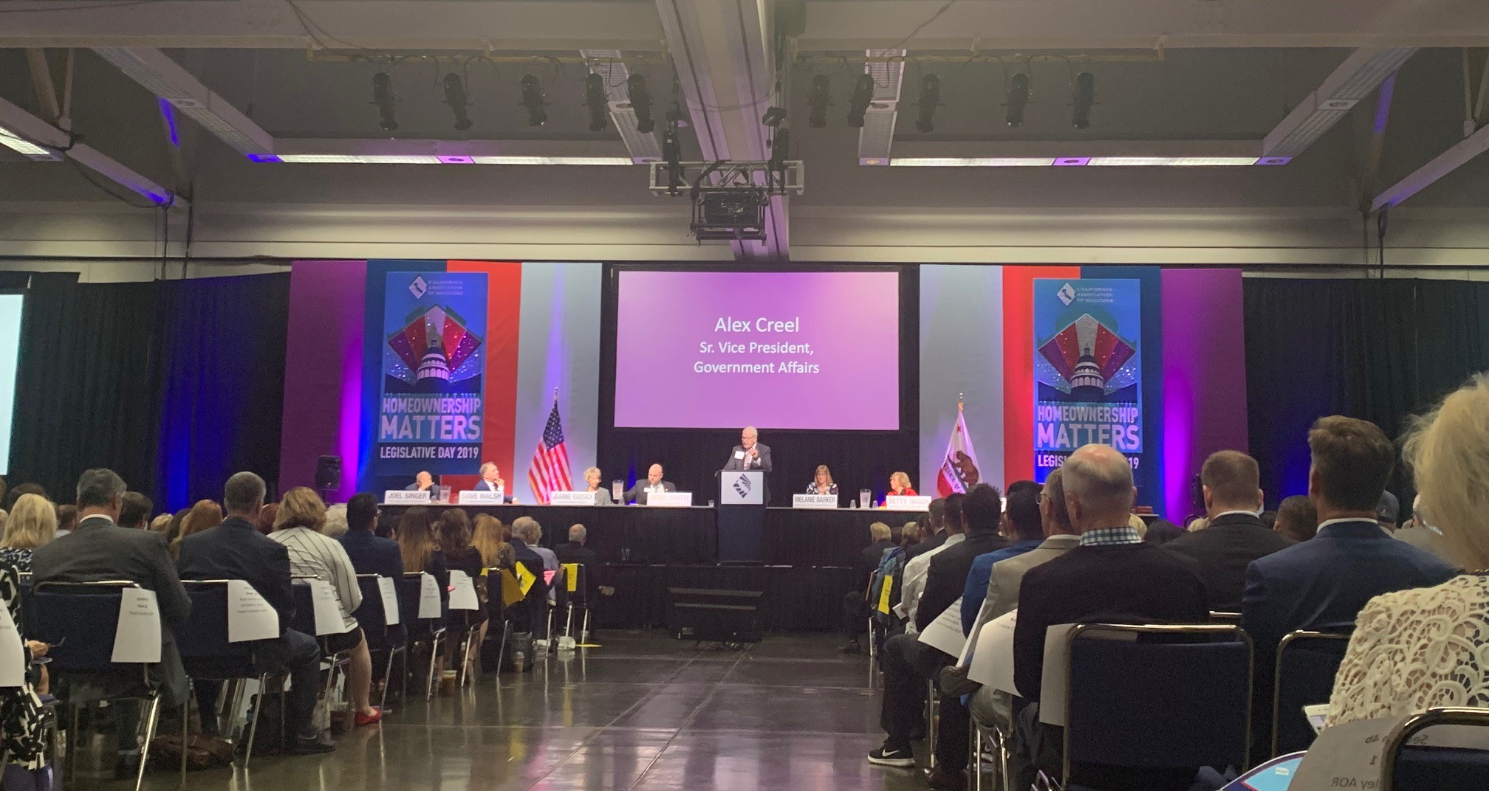

Slide 14
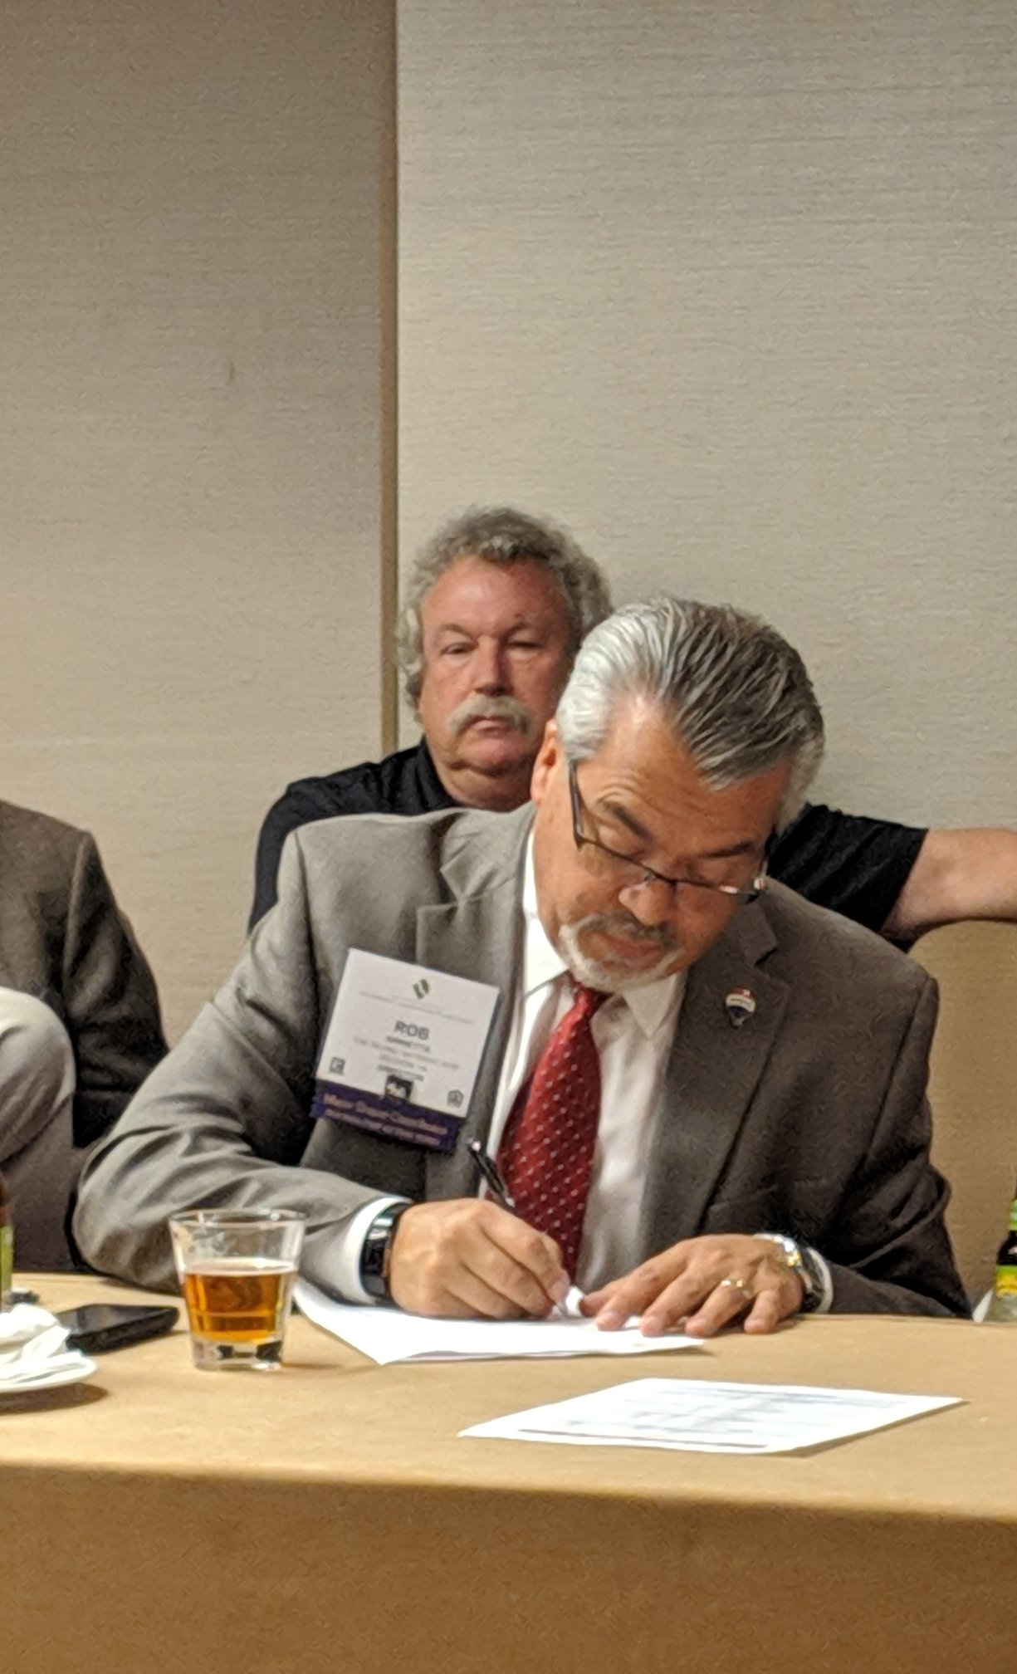
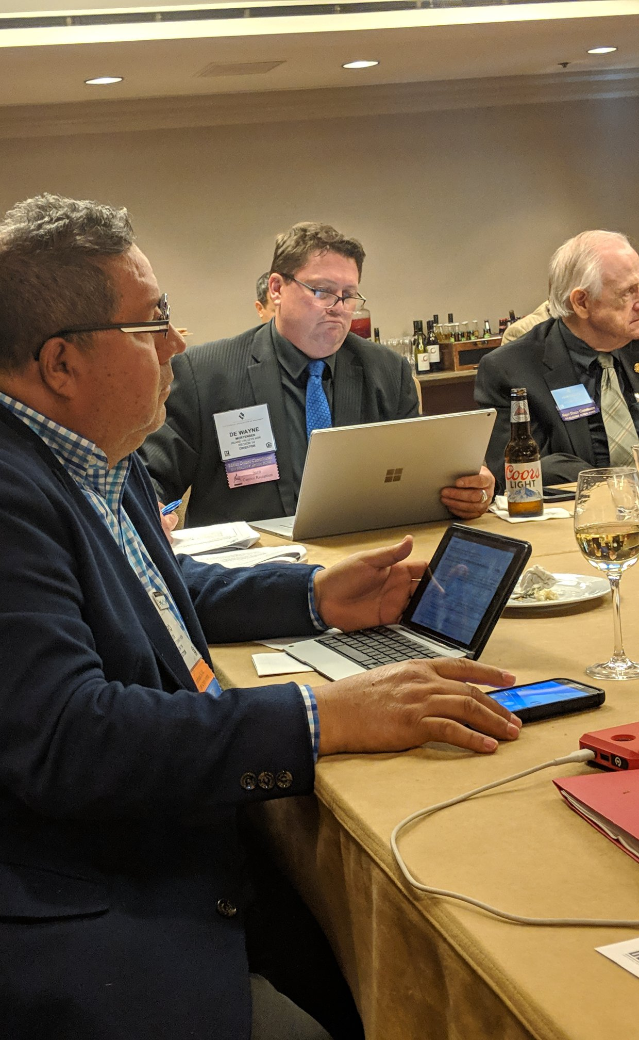
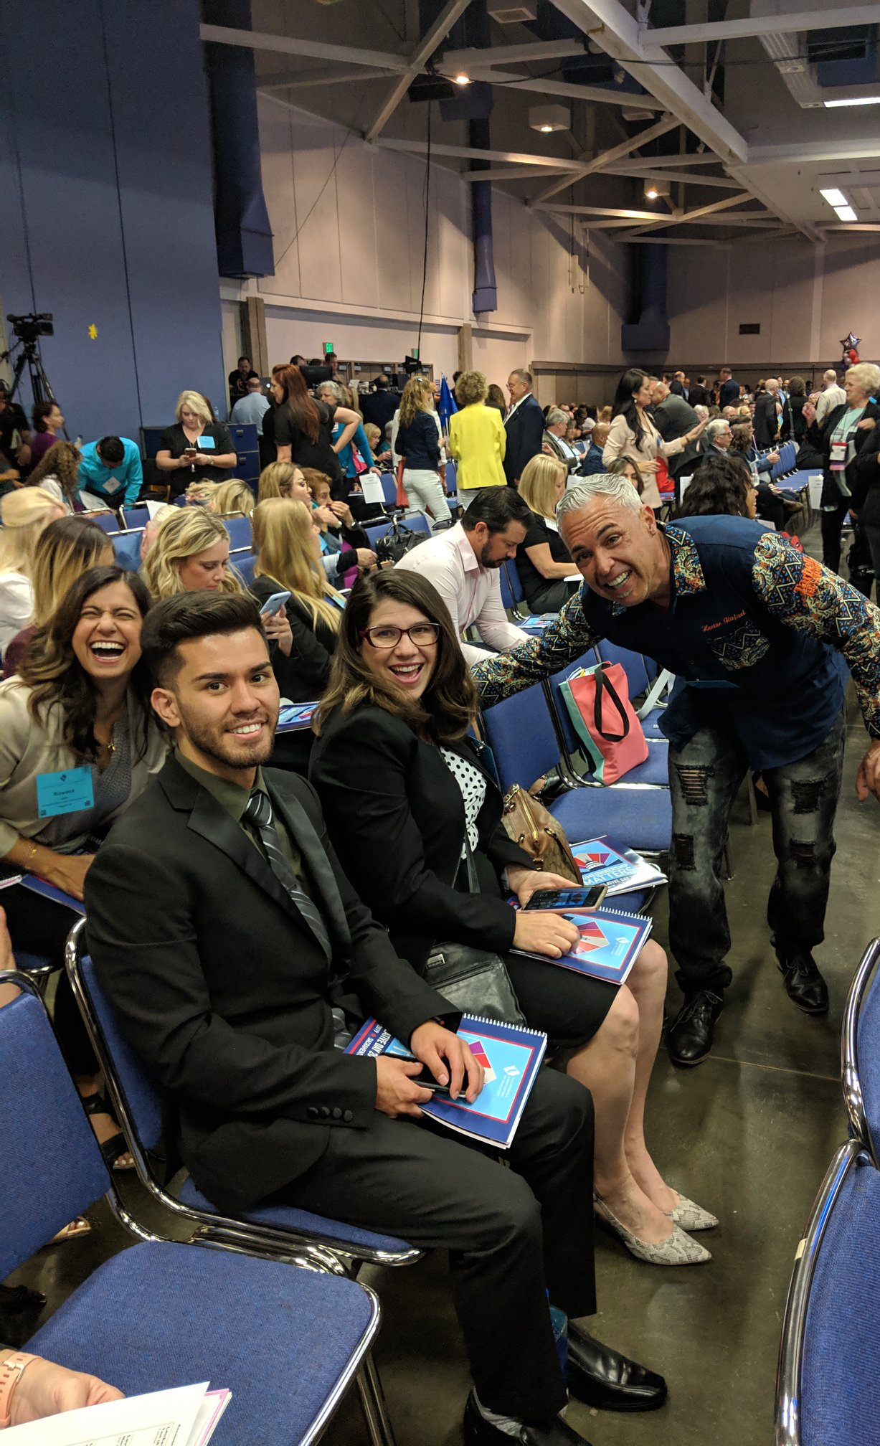

Slide 15
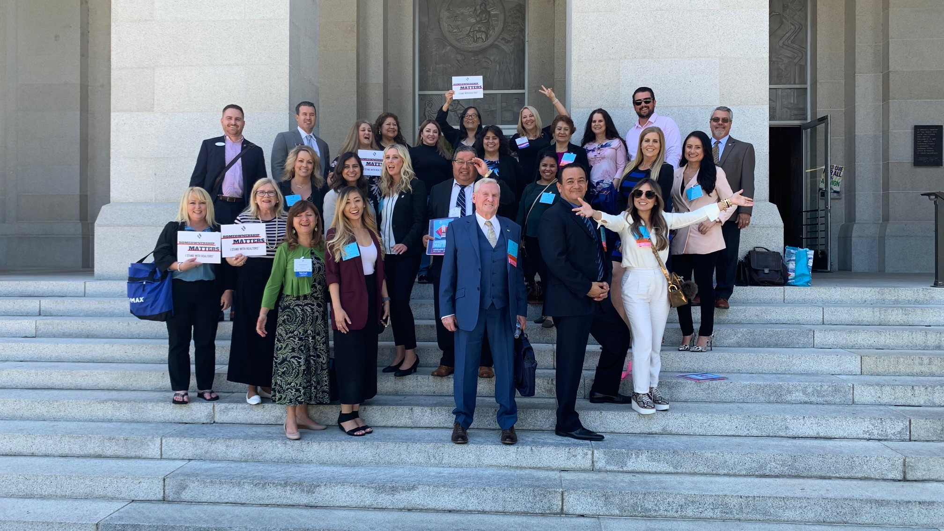

Slide 16
Tony Capitelli
CEO

Slide 17
James Free
TIGAR President

Slide 18
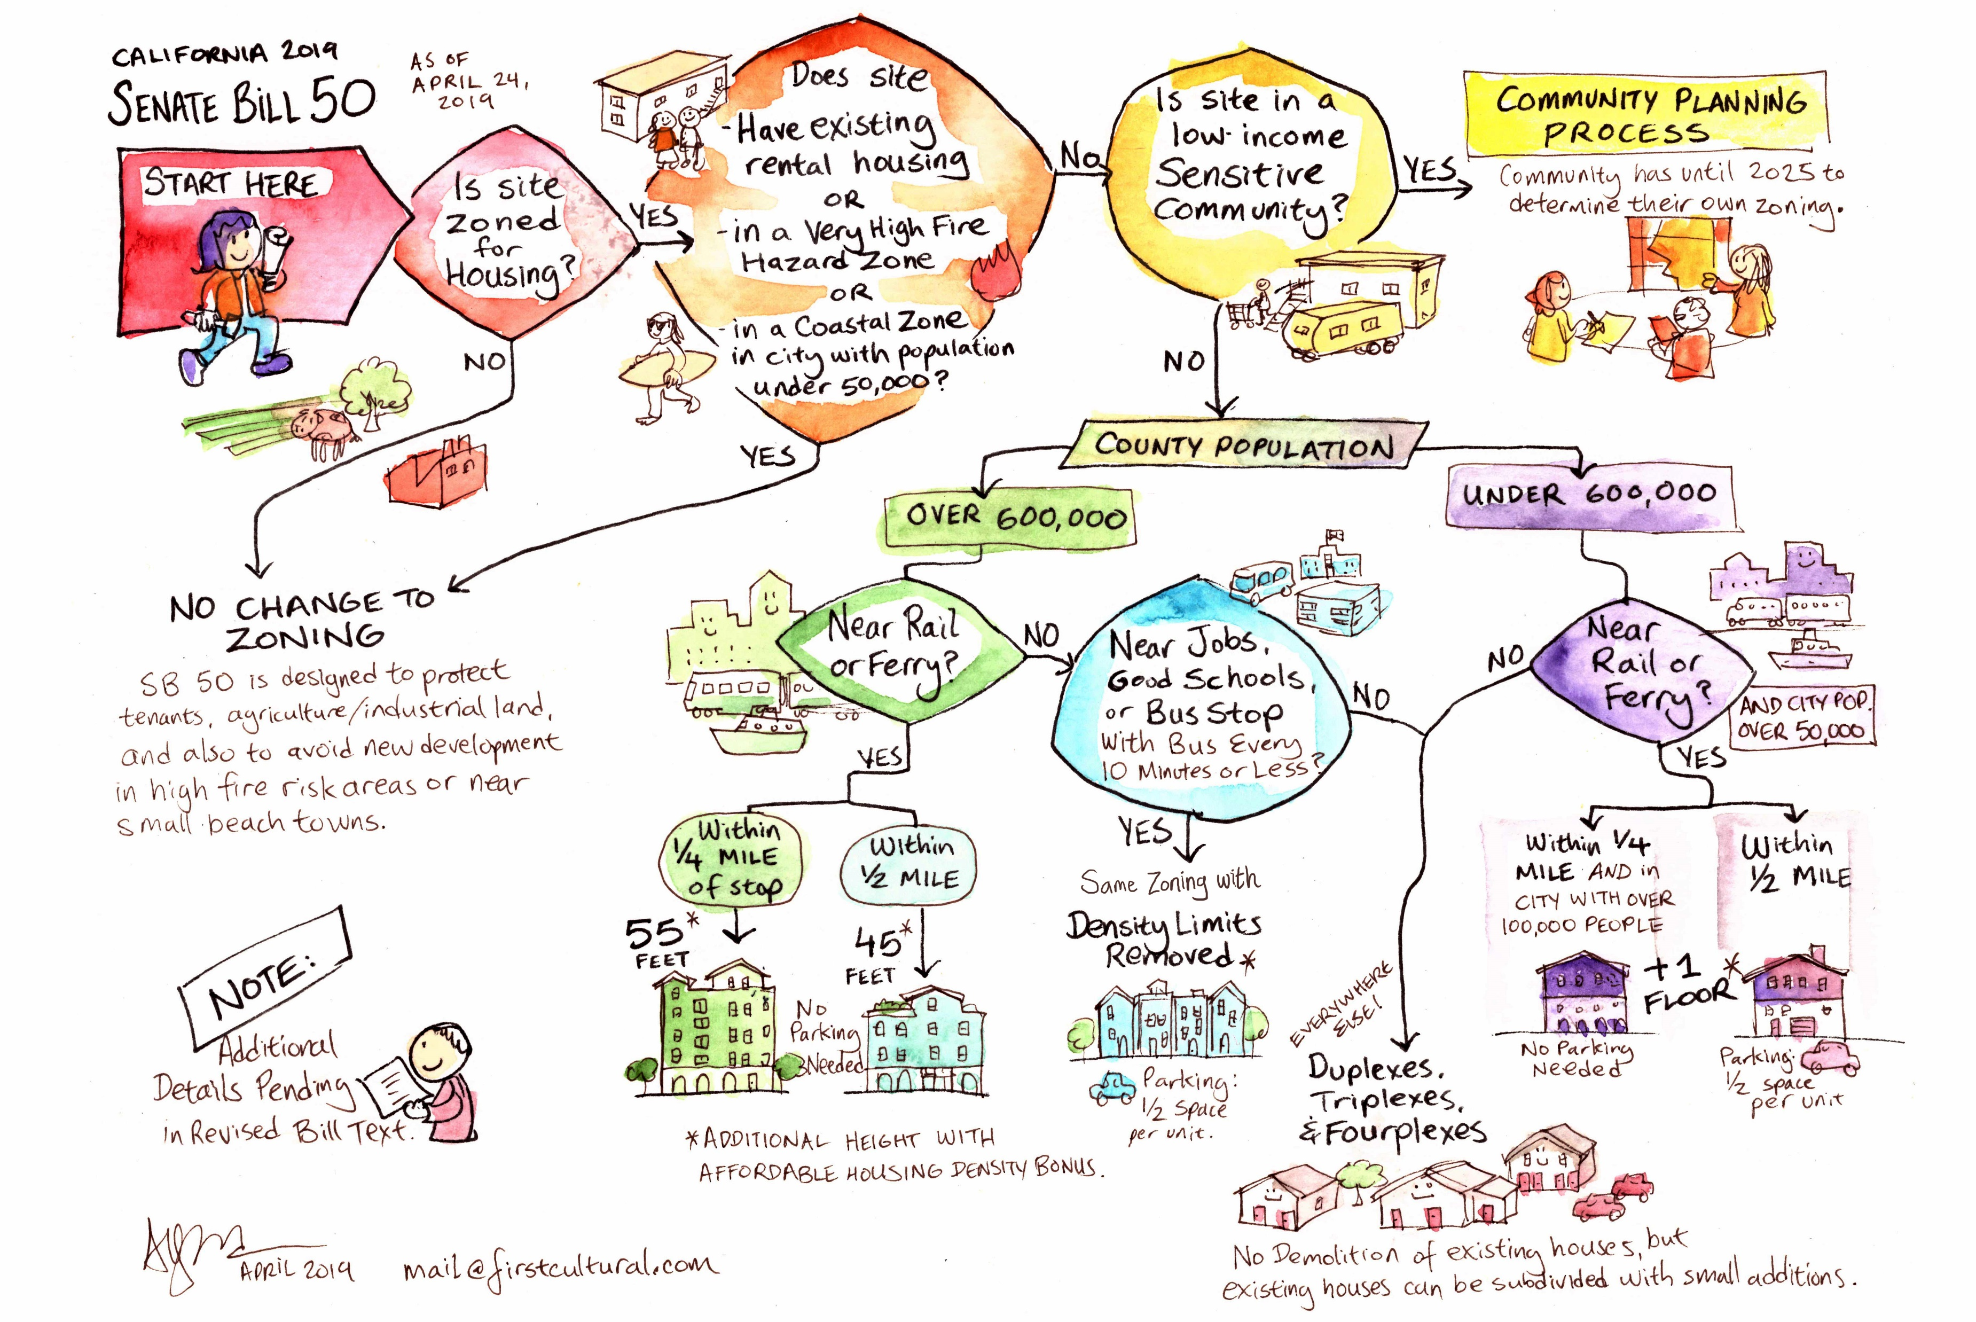

Slide 19
Manny De Silvia
Region 14 Chair

Slide 20
Investment Housing Action Items
1. That CAR Adopt an “OPPOSE UNLESS AMENDED” position on AB 1482 (Chiu), which places a statewide cap on the amount that a rental property owner may annually increase rent. Legislative Committee: Approved
2. That CAR adopt an “OPPOSE UNLESS AMENDED” position on AB 1481 (Bonta) and AB 1697 (Grayson), which prohibit a rental property owner from terminating a lease without just cause. Legislative Committee: Approved
3. That CAR adopt an “OPPOSE UNLESS AMENDED” position on AB 36 (Bloom), which modifies the Costa-Hawkins Rental Housing Act. Legislative Committee: Approved
4. That CAR “SUPPORT” SB 521 (Portantino), which establishes a tax credit for rental property owners for dwellings or units that are rented or leased to persons receiving assistance under Section 8. Legislative Committee: Approved
5. That CAR adopt a “WATCH” position on AB 1110 (Friedman), which heightens notice requirements for a rental property owner of a residential dwelling with a month-to-month tenancy who increases the rent by more than 10%. Legislative Committee: Approved

Slide 21
Jackie Barndollar Landry
CAR Director

Slide 22
Adriana Nagel
CAR Director

Slide 23
Jeannie Hallgrimson
CAR Director

Slide 24
Lazaro Morales
CAR Director

Slide 25
Sarah Oswald
CAR Director

Slide 26
Rob Arrietta
CAR Director

Slide 27
Frank Nelson
NAR & CAR Director

Slide 28
Jessica Fragoso
YPN Chair

