Slide 1
TIGAR
Good Morning

Slide 2
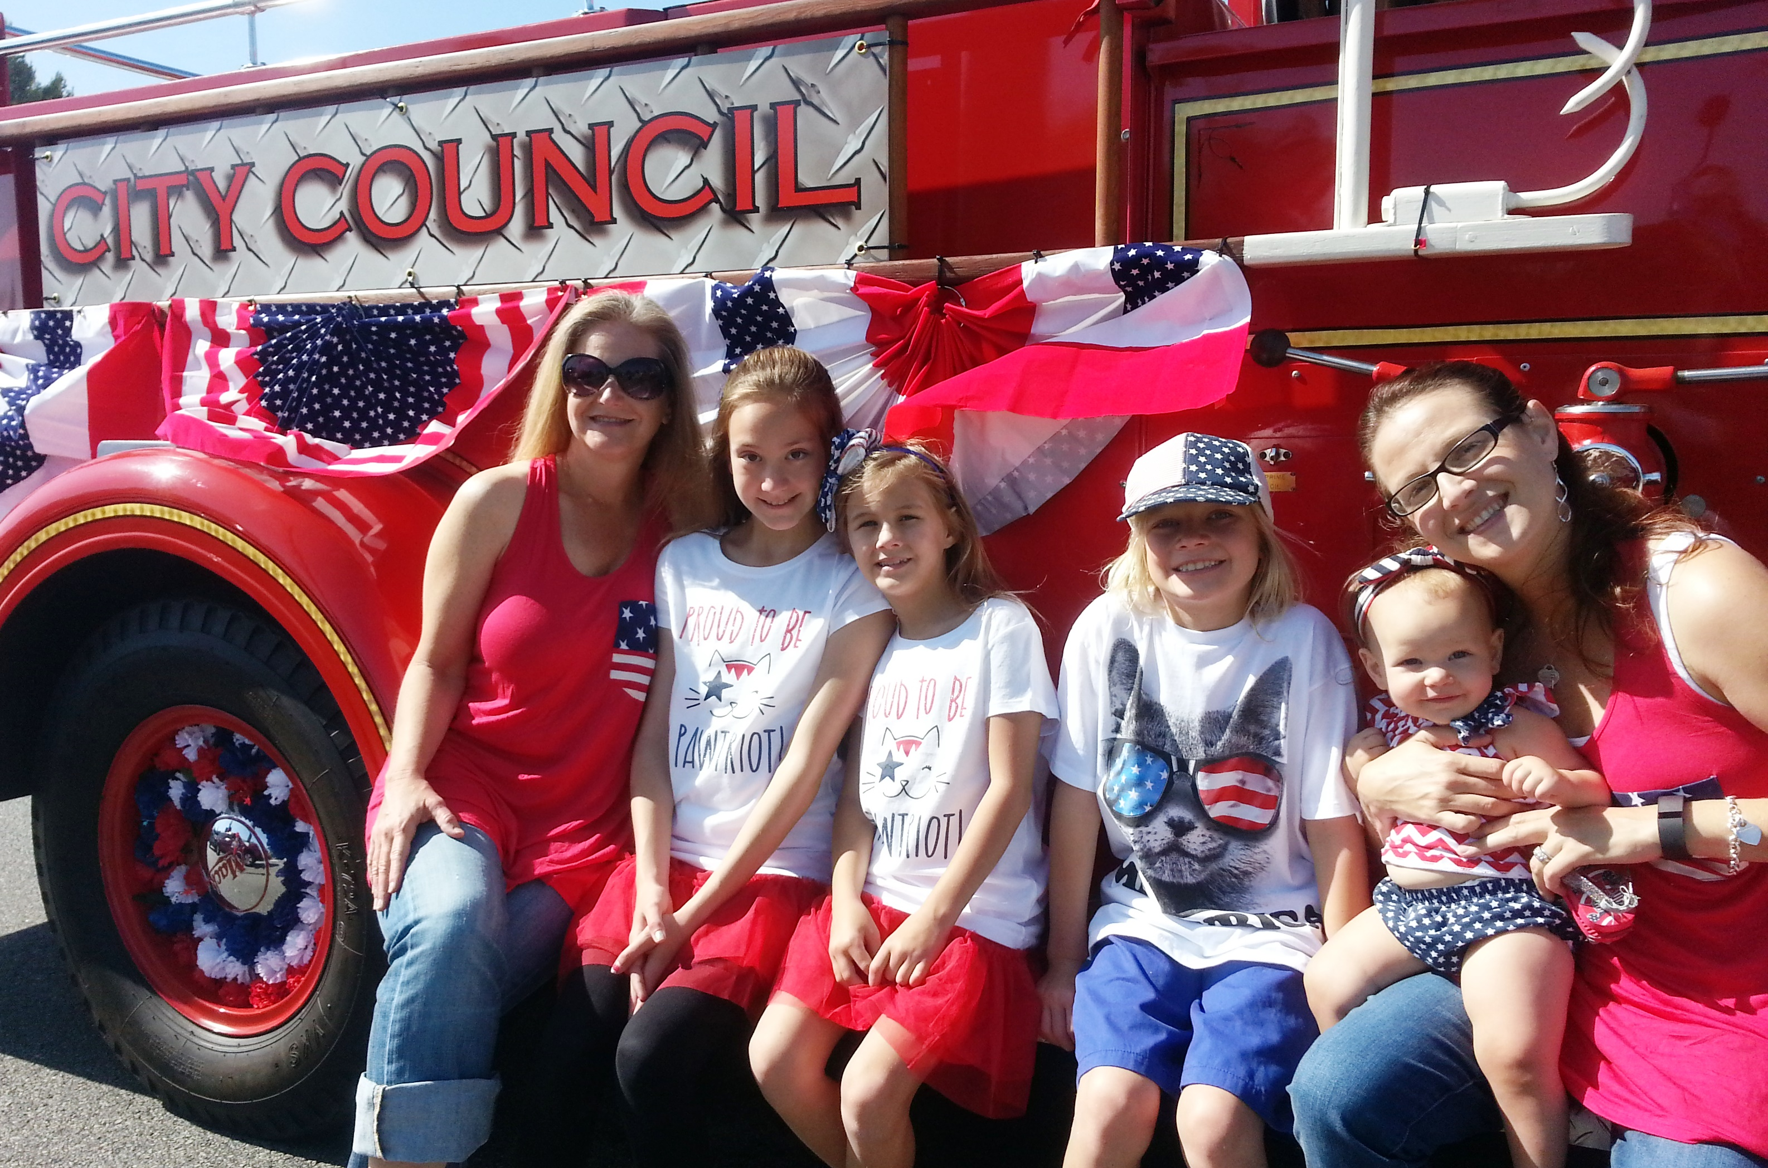
Jason Scott, Mayor
CITY
City Councilman since 2008
Mayor in 2013, 2016, and currently
Member of Council Infrastructure Committee
Member of Council Finance, Legislation, and Economic Development Committee
Member of the Executive Board of Western Riverside Council of Governments
OCCUPATION
Corona-Norco Unified School District
* Principal the past 30 years
* Teacher for 10 years
PERSONAL LIFE
Widowed from wife Dee Scott. She died of pancreatic cancer. Married 30 years.
Two daughters (Cherise and Shar) and two sons-in-law (Jon and JD)
Four grandkids (Samantha 16, Jack 12, Tylor 11, Savannah 3)
Dating Karen Wuflestad (Knew each other from 38 years ago)

Slide 3
Homeless
City Council Homelessness Resources Committee
- Path to Life – 5 Beds
- Working with Police Department
- Working with County Department of Social Services
- Working with County Veteran’s Services
- Shelter w/ Resources
City Net hired
Budget - $1M

Slide 4
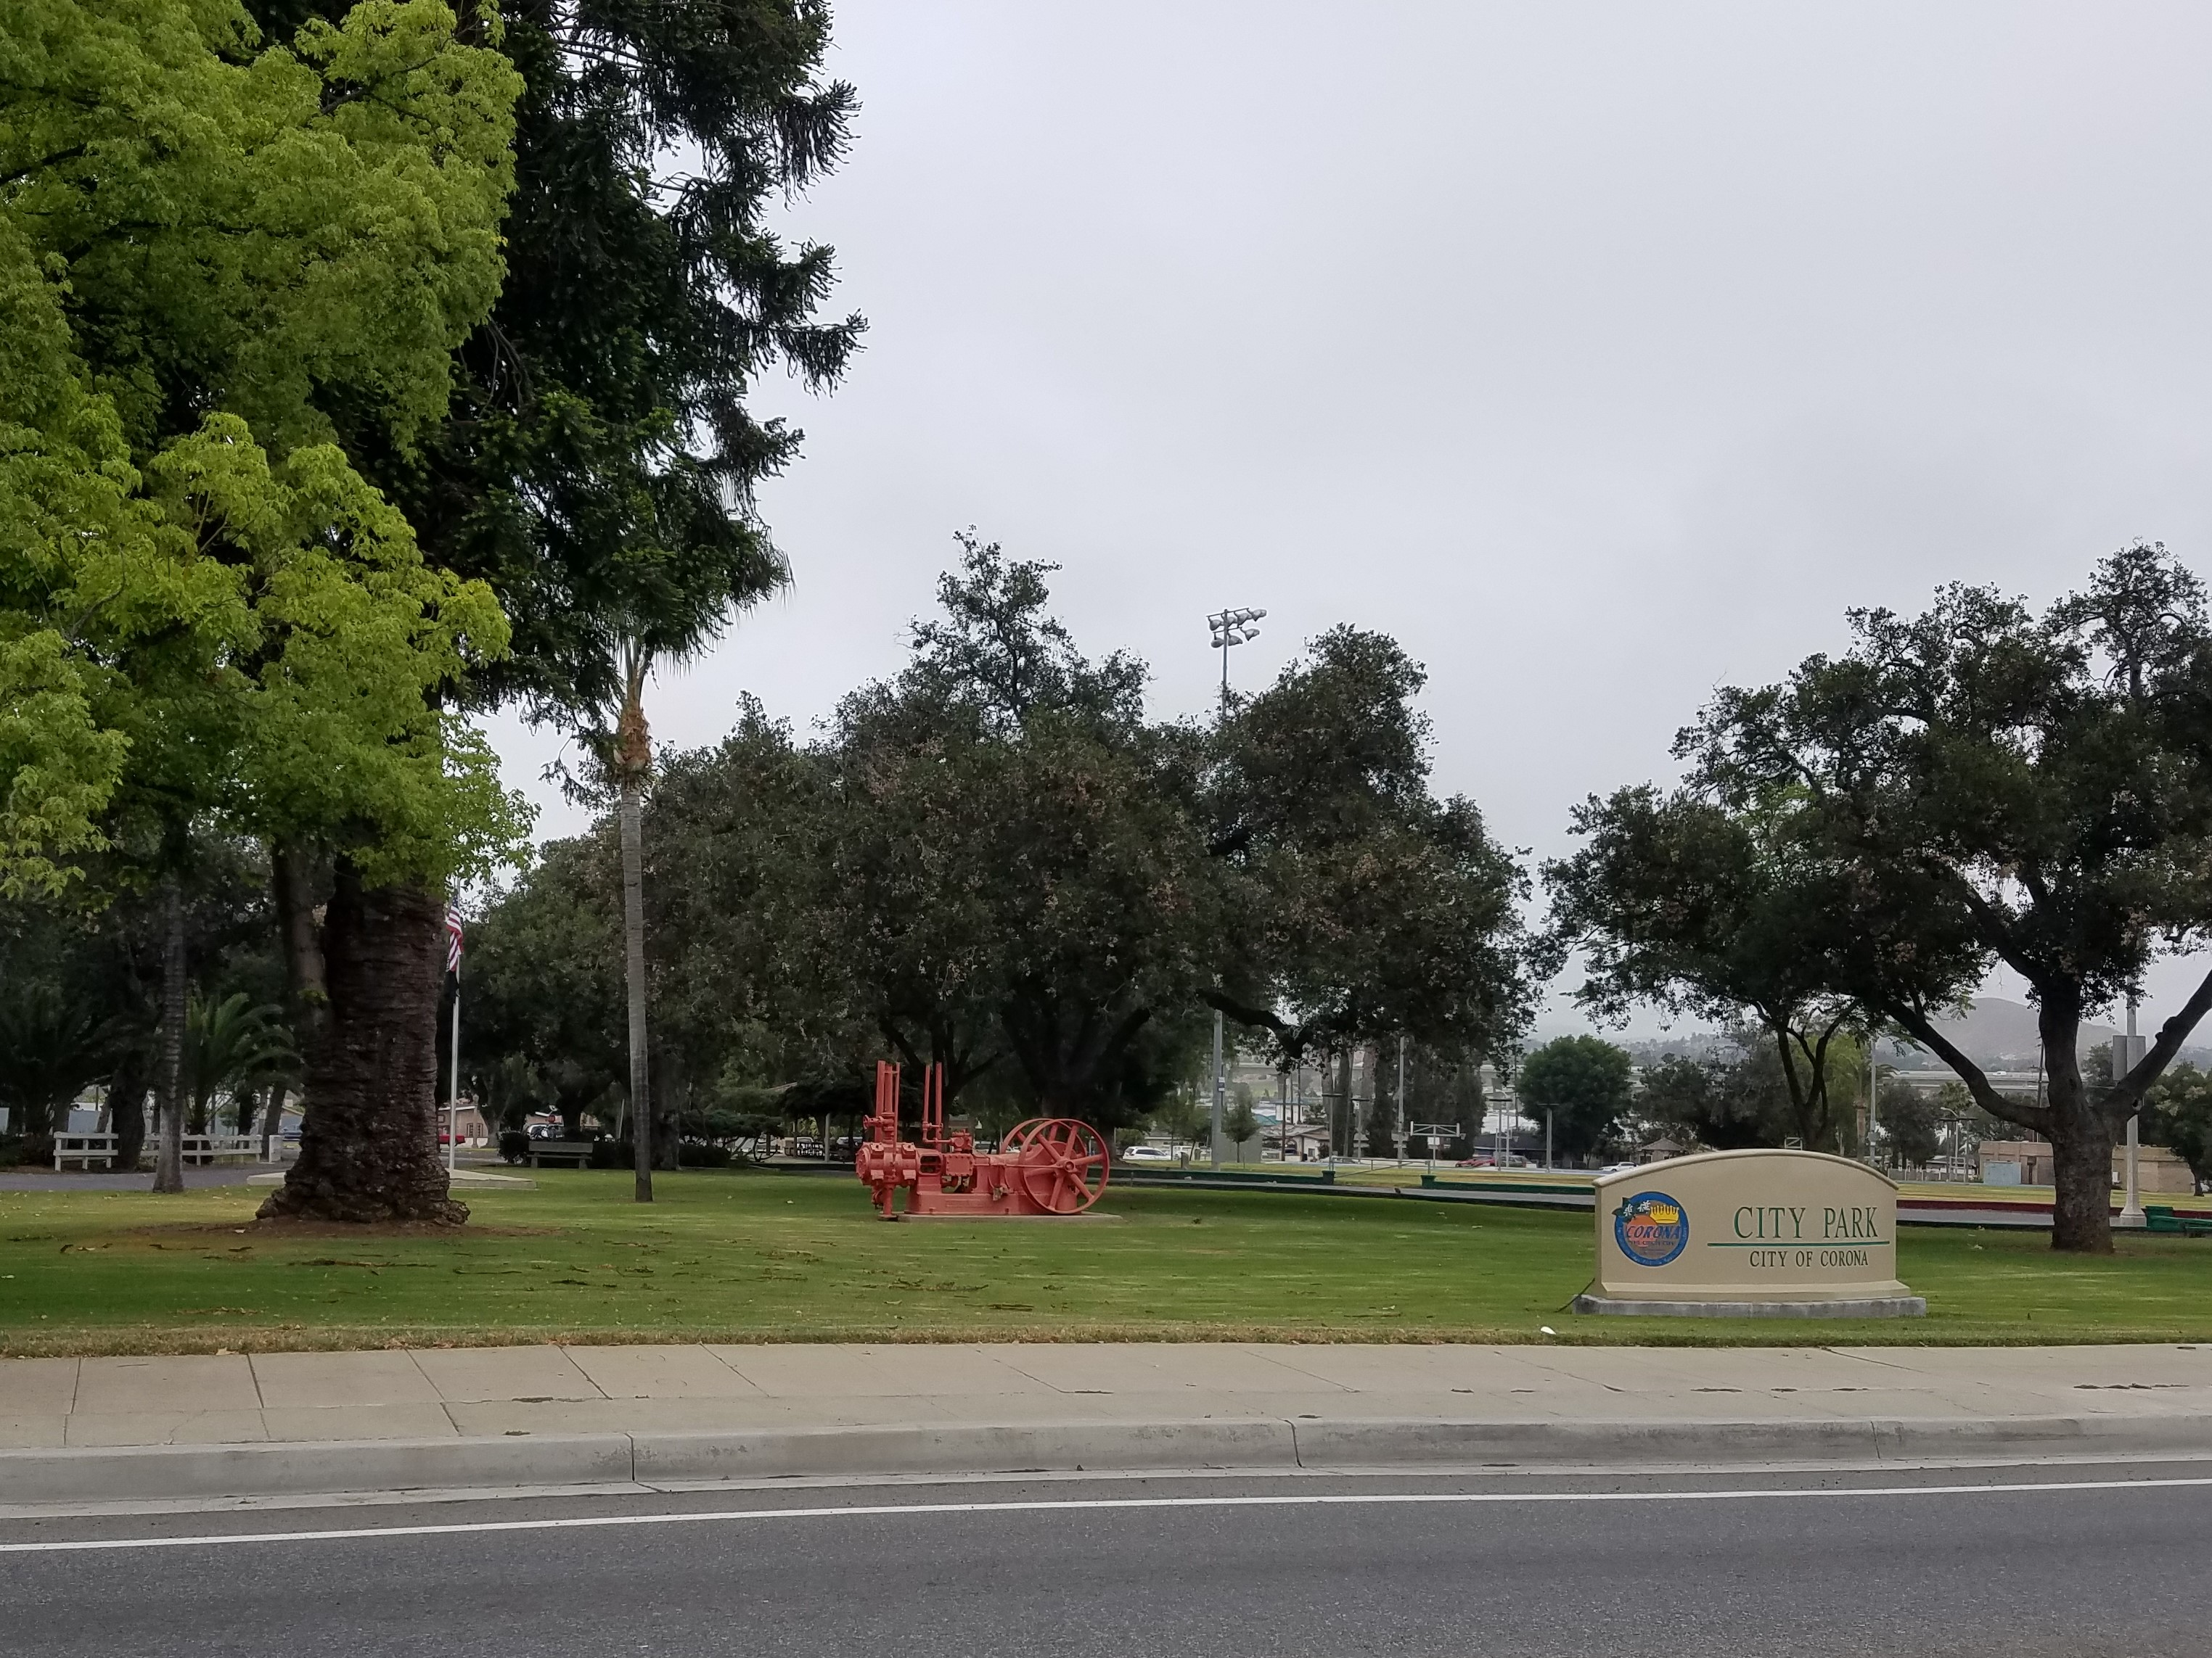
City Park - Grants
You are invited to join the City of Corona at City Park on Wednesday, May 29, 6 p.m. - 7:30 p.m., to discuss a variety of potential park improvements. Consider these possibilities:
Expand the park and build a senior/community center;
Replacement of the existing pool with a state-of-the-art aquatic center with competition pool, interactive splash play area, and giant slides;
A fitness trail;
New playground equipment;
Improved sports fields; and
Additional parking.

Slide 5
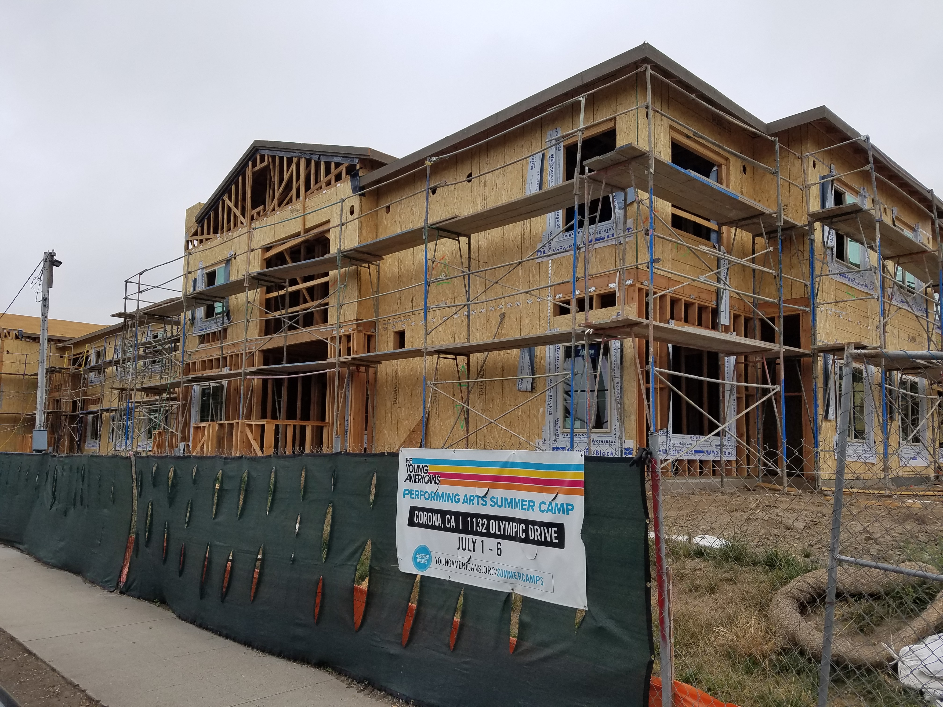
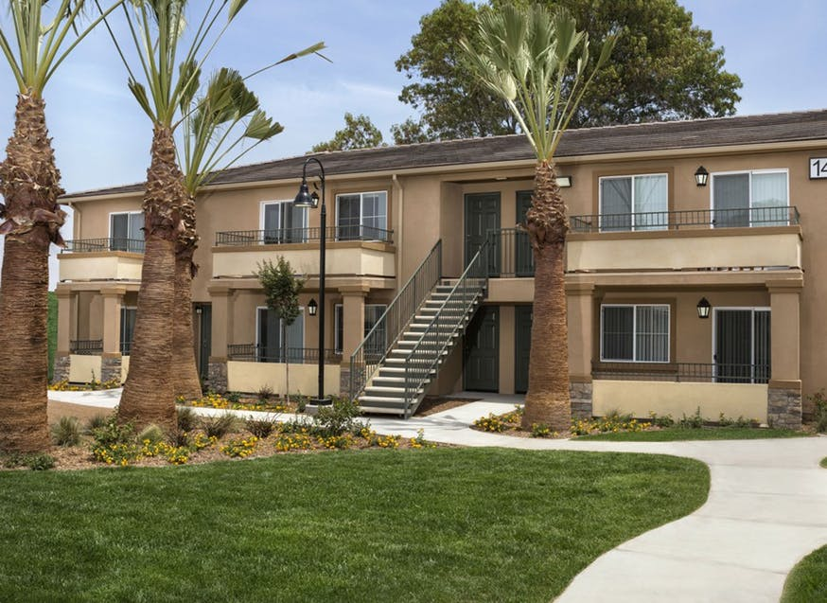
Workforce Housing
Housing is expensive in Corona.
Workforce housing provides
Housing opportunities for those
with jobs but in the lower income
brackets.
Rents run around $550 to $1,200
a month for a 3 bedroom
Apartment.
There is a waiting list of about
400 people who have jobs seeking
Housing.
# of People | Annual Income Maximum
1 | $28,320
2 | $32,040
3 | $36,420
4 | $40,440

Slide 6
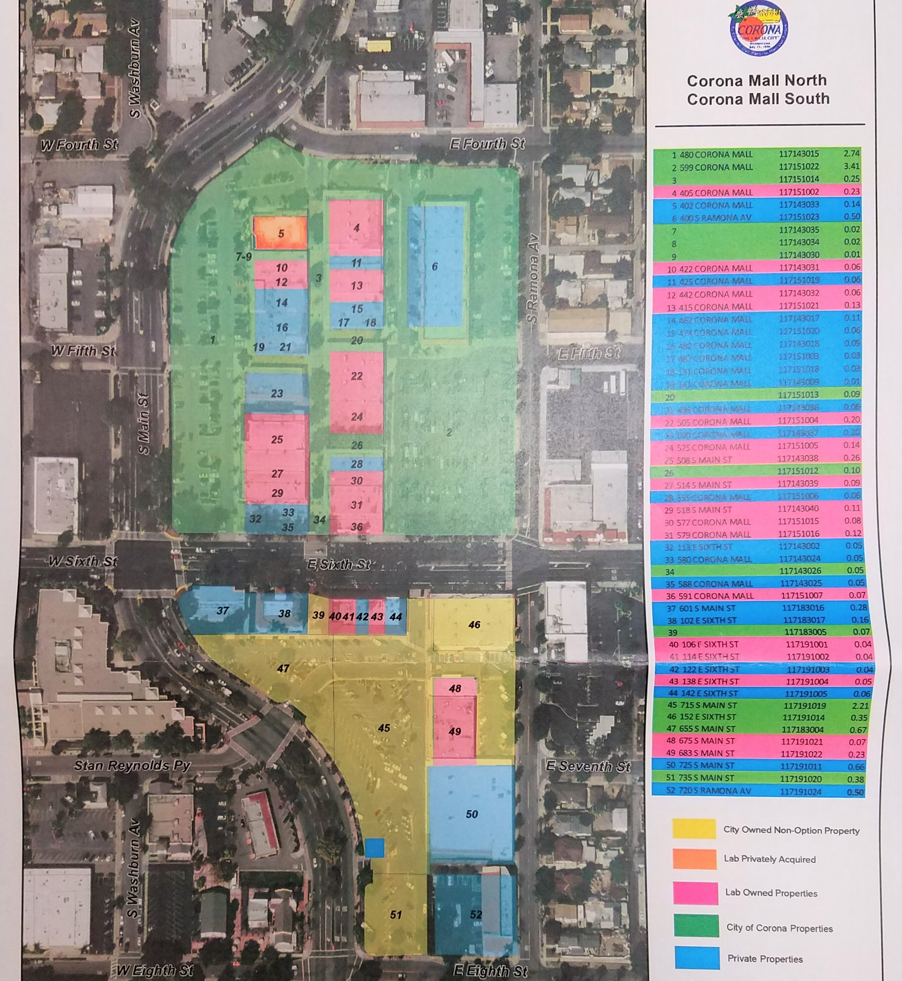
Corona Mall – The Lab
BLUE – Private Properties
PINK – Lab Owned
YELLOW – City Owned
ORANGE – Lab Acquired

Slide 7
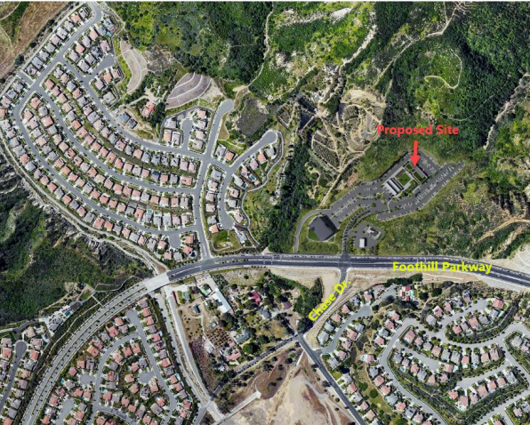
Foothill Commercial
17 Acres
South side of Foothill
West of Trudy Way
(Orchard Glen)
and Skyline Trail
------
Tentative
Retail,
Office,
Gas Station,
Music Venue

Slide 8
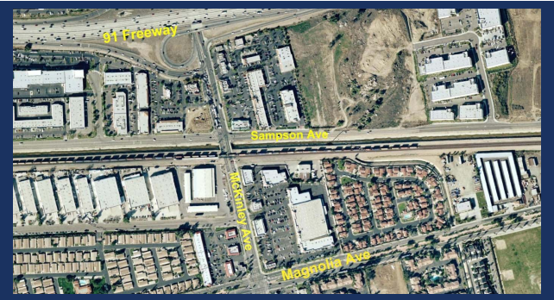
McKinley Street Grade Separation (Bridge)
$84.45 Million – SB 132
June 30, 2013
Other Funding: $9.58 M
Projection: $111.9 M
A Value Engineering Study
is currently in process
Train Numbers Per Day 2019 – 90 2035 – 137
RR Gate Down Time 2019 – 2 hrs 40 min 2035 – 4 hrs 20 min

Slide 9
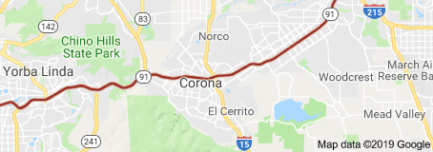
91 Freeway
Coming:
+ An all-purpose lane from Green River to 241
called the Corridor Operations Project (COP)
- Construction slated to start in Fall 2020
- $42 million
+ Flyover ramp from 91E to 71N to be completed for $180 million
+ 241 drop down into 91 Express Lanes

Slide 10
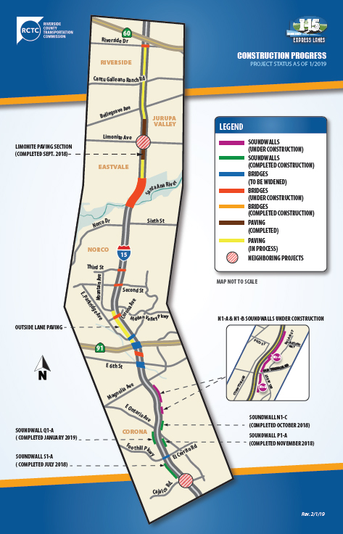
15 Freeway
$471 Million by RCTC
2 Express lanes in both directions from Cajalco to the 60 freeway
and expect to open in 2020
The 15/91 Express Lanes Connector
(15S → 91W and 91E → 15N) has a separate funding source and is
expected to open in 2022

Slide 11
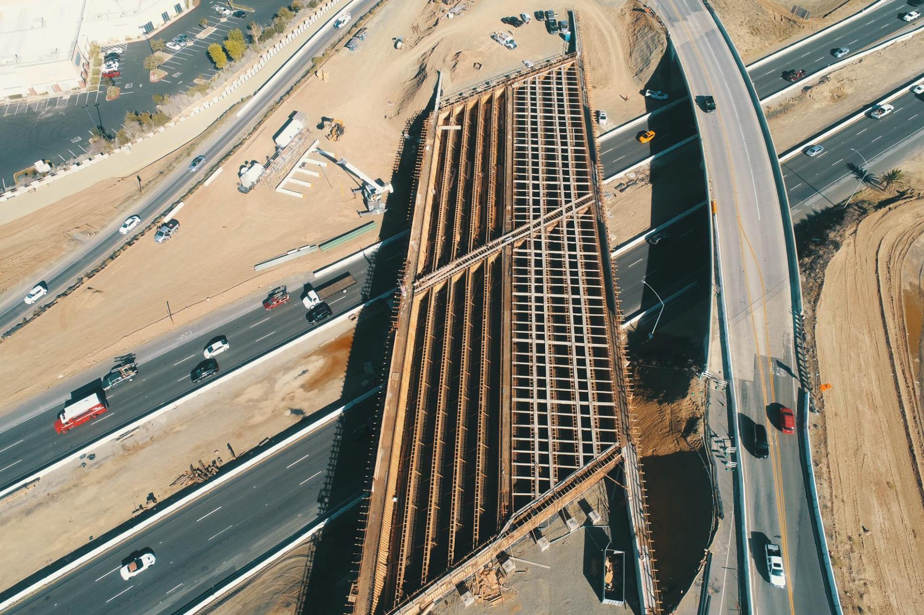
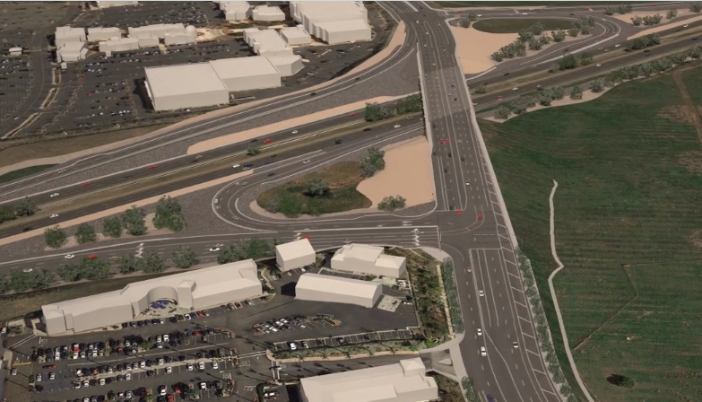
Cajalco Interchange
New Home Company, who is
building the Arantine Hills
development, is obligated to
pay up to $70.4 million to
Complete the interchange.
+ New bridge
+ From 2 to 6 lanes
+ Sidewalk on the south side

Slide 12
Budget
REVENUES: $364,771,795
EXPENSES: $334,891,604
CalPERS Pension – 2017-2023 = $34.1M to be paid which includes a $2.3 M payment increase for this year
6% increase to cover health costs of employees
Minimum Wage increases included:
2019 = $12, 2020 = $13, 2021 = $14, 2022 - $15
Funds to do an updated Strategic Plan, New Pet Waste Stations at Parks,
Expansion of Youth Sports Summer Program, Replace Playground Equipment,
2 Community Service Officers added, 4 Police Officers added, and continuation of quality services for maintaining infrastructure.

Slide 13
City Manager
Acting City Manager Mitch Lansdell
RFP for Consultant
Hired Lamont Ewell
of Ralph Andersen &
Associates
Process underway to
hire our permanent
City Manager

Slide 14
Thank you
Jason Scott, Mayor
(951) 736-2371
Jason.Scott@CoronaCA.gov
City Website:
CoronaCA.gov
Copyright: Jason Scott 2019

