Slide 1
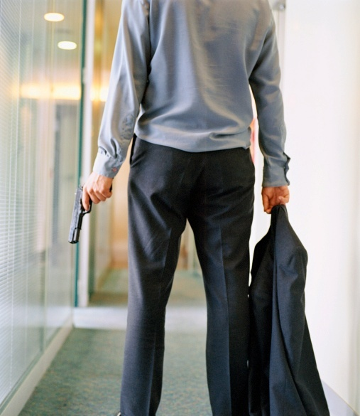
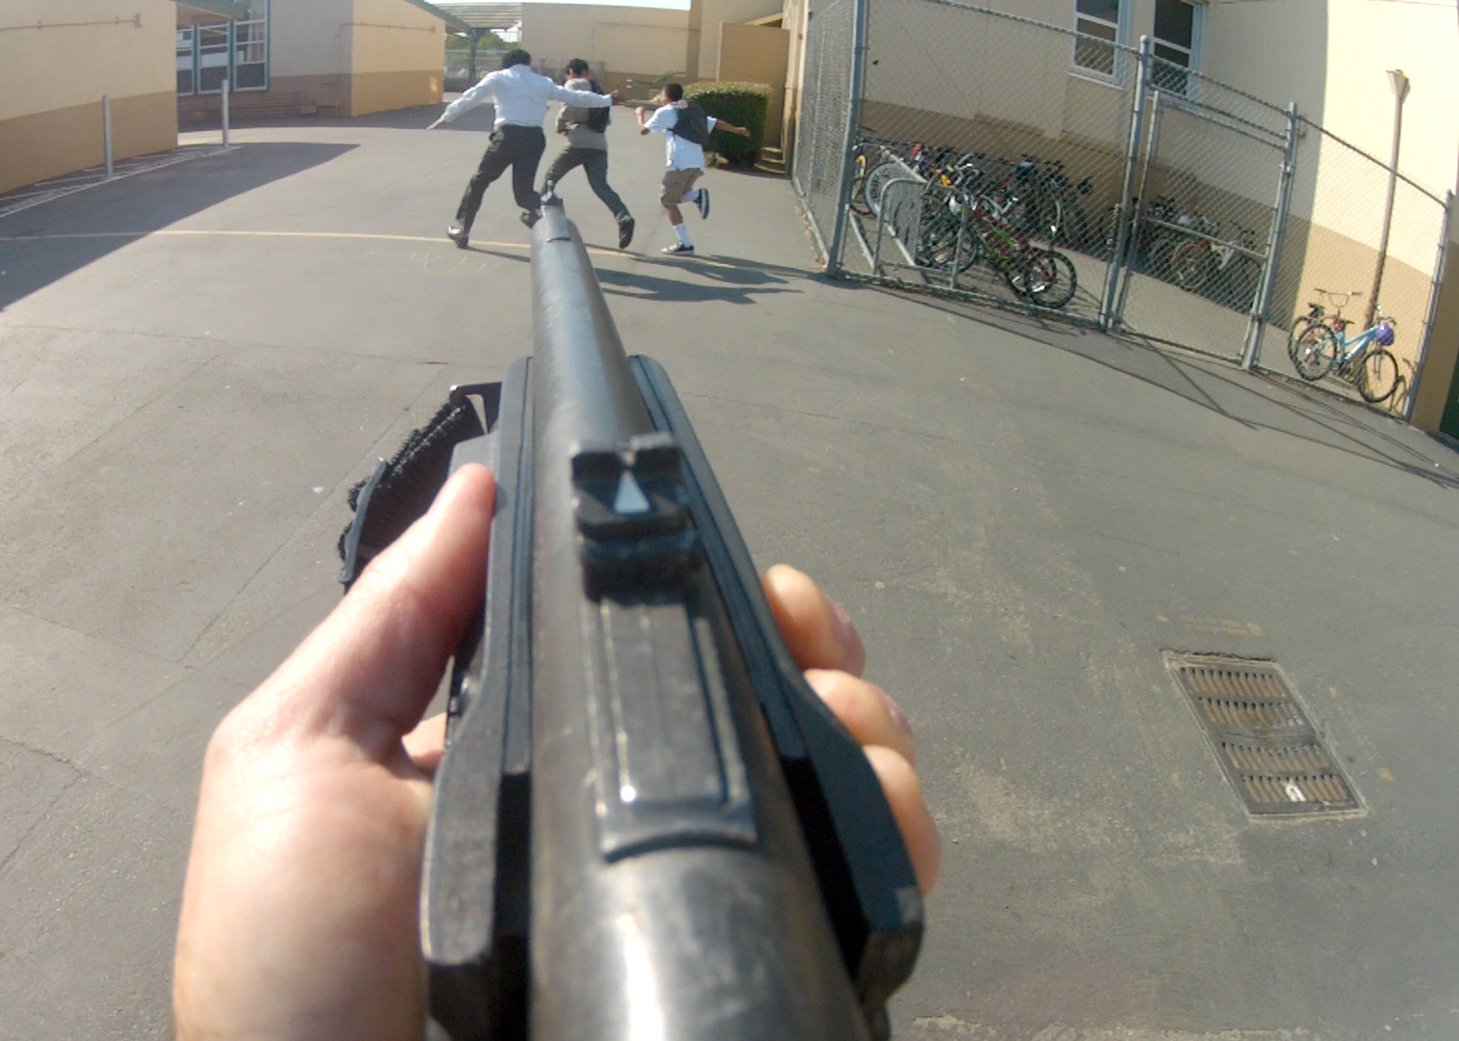
Active Shooter Response Training
Notes:
This version is oriented towards schools.

Slide 2
Definition of an Active Shooter
An Active Shooter is a subject or subjects actively engaged in killing or attempting to kill people in a confined and populated area; Active Shooters primarily use firearms and there is no pattern or method to their selection of victims
Shooting spree may be random or systematic
Objective is mass murder rather than other criminal intent
Notes:
The term “Violent Intruder” may provide a more comprehensive alternative to “Active Shooter”.

Slide 3
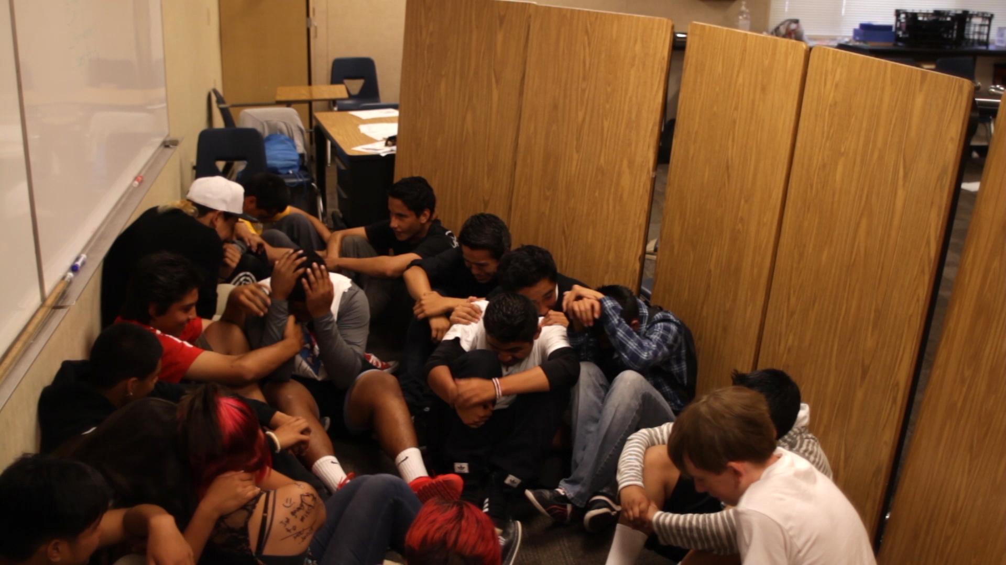
Active Shooter Events
Unpredictable
Evolve quickly
Continue until stopped by law enforcement, suicide or other intervention

Slide 4
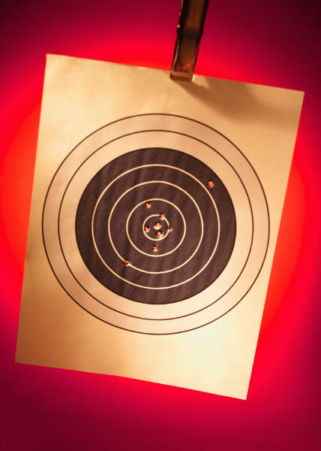
The Active Shooter’s Intent
Views the attack as attempting to correct a perceived wrong
Usually has a “hit” list and will search victims out
The Shooter often takes out targets of opportunity on the way

Slide 5
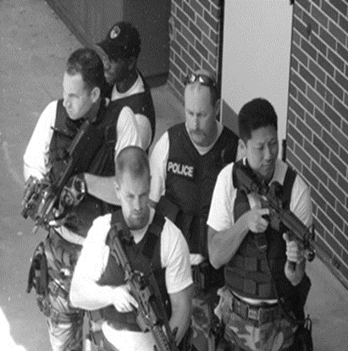
An Active Shooter Expects To Die
Not concerned with dying so has nothing to lose
Moves throughout a building or area until either
stopped by police
commits suicide
self
suicide by cop
stopped by others

Slide 6
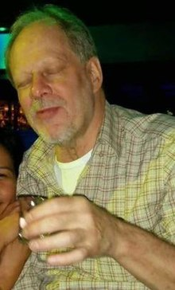
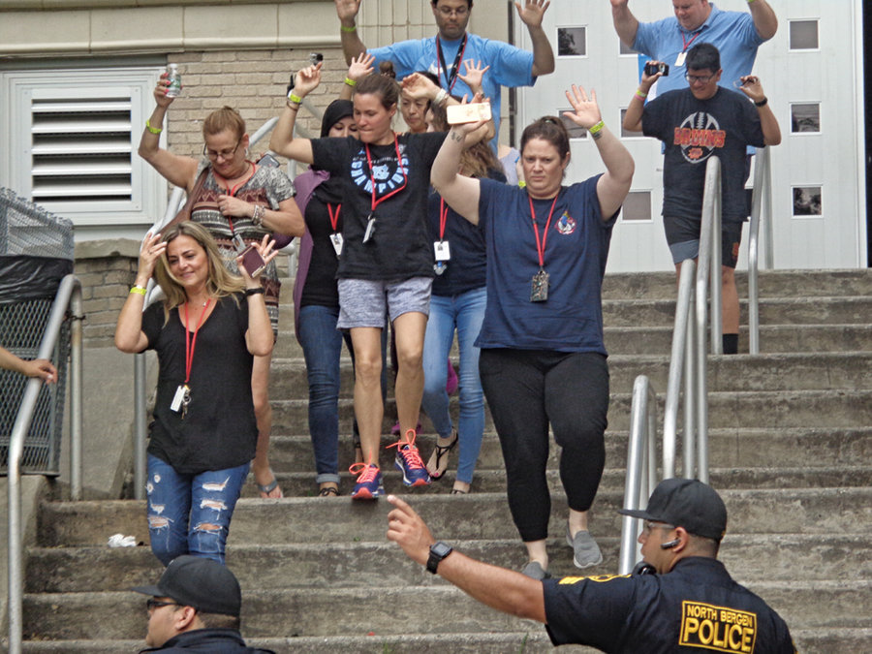
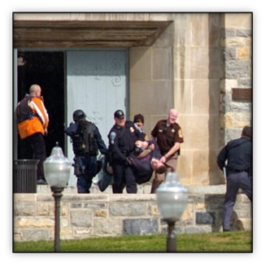
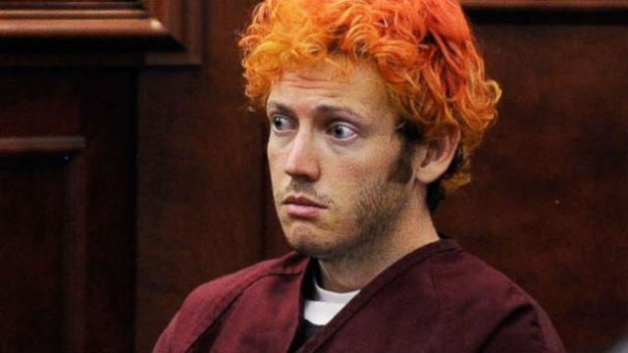
ACTIVE SHOOTER Modus Operandi
Lone Wolf
2/3
Assault Team

Slide 7
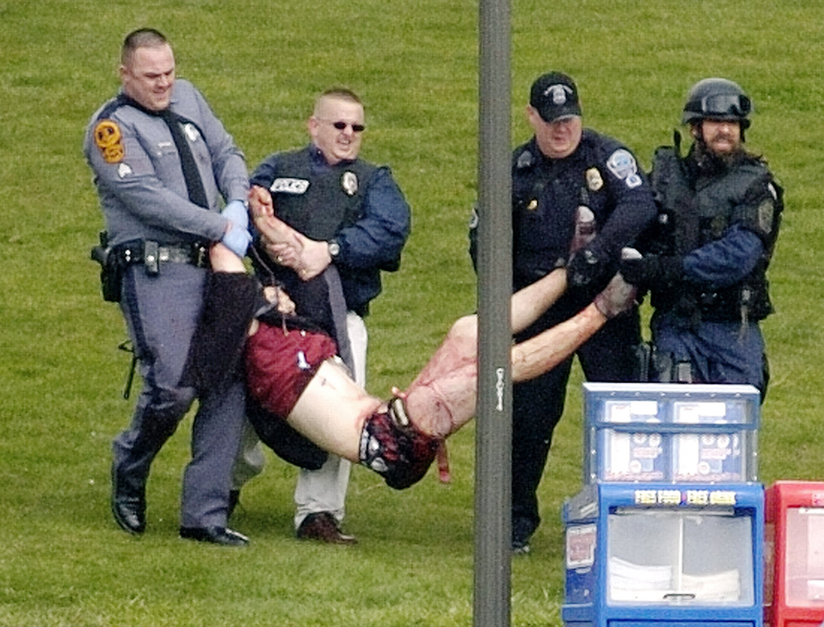
Cho Seung-Hui Virginia Tech BLACKSBURG, VA 4-16-2007
History of mental illness
Posted pictures before & mailed info to NBC during
32 Dead and 23 Wounded
Weapons: Glock 19, Walther P22
Committed suicide at scene
Rationale:
Savior oppressed & rejected
Romantic dispute?
Teased about speech disorder

Slide 8
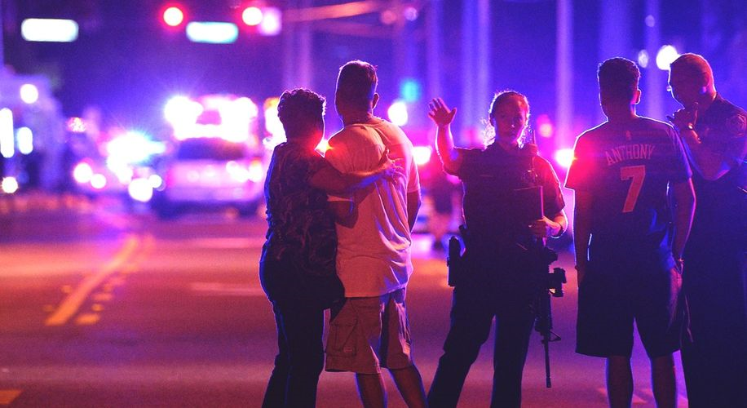
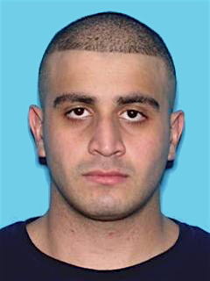
Omar Mateen PULSE Nightclub ORLANDO, FL 4-16-2007
Claimed affiliation with ISIS
Failed to become a FL State Trooper and Corrections officer
49 Dead and 58 Wounded
Weapons: Sig Sauer MCX, Glock 17
Killed in shootout with Orlando SWAT
Rationale:
Officials believed he was gay and was spurned by latino men

Slide 9
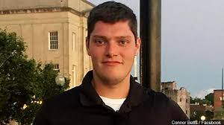
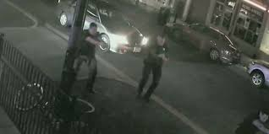
CONNOR BETTS NED pEPPERS BAR DAYTON, OH 9-4-2019
Opened fire from across the street and attempted to enter crowded bar
9 Dead and 17 Wounded. His sister was on of the first people he killed
Weapons: AR-15 with 100 round drum
Killed in shootout with Dayton PD within 32 seconds
Rationale:
Fascinated with Mass shootings and displayed violent tendencies towards women.

Slide 10
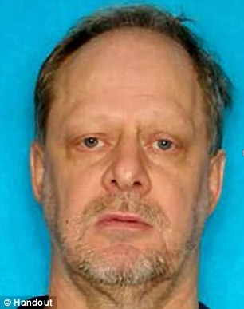
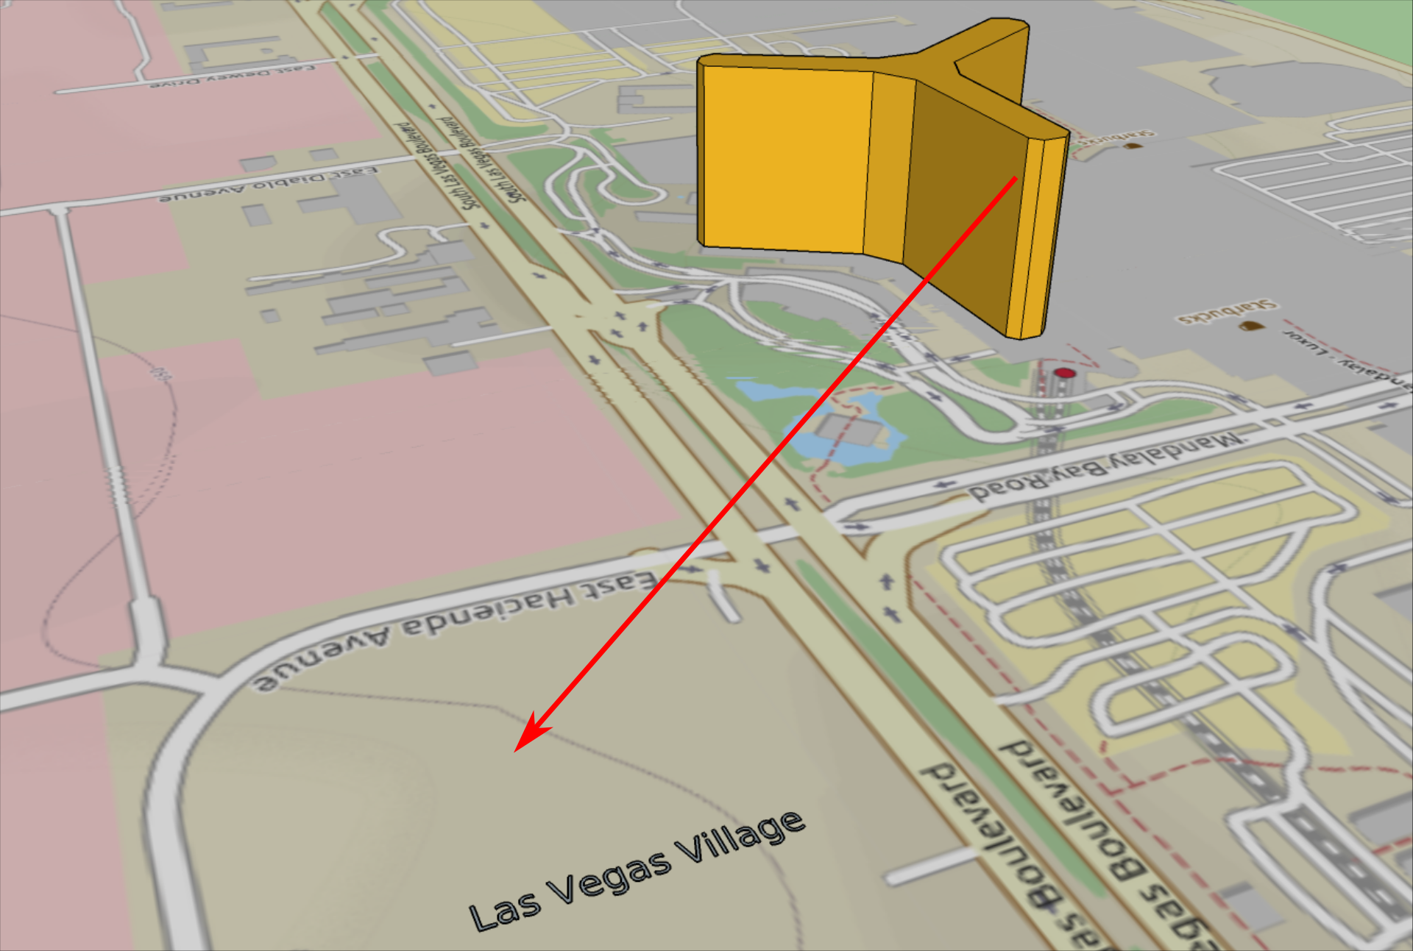
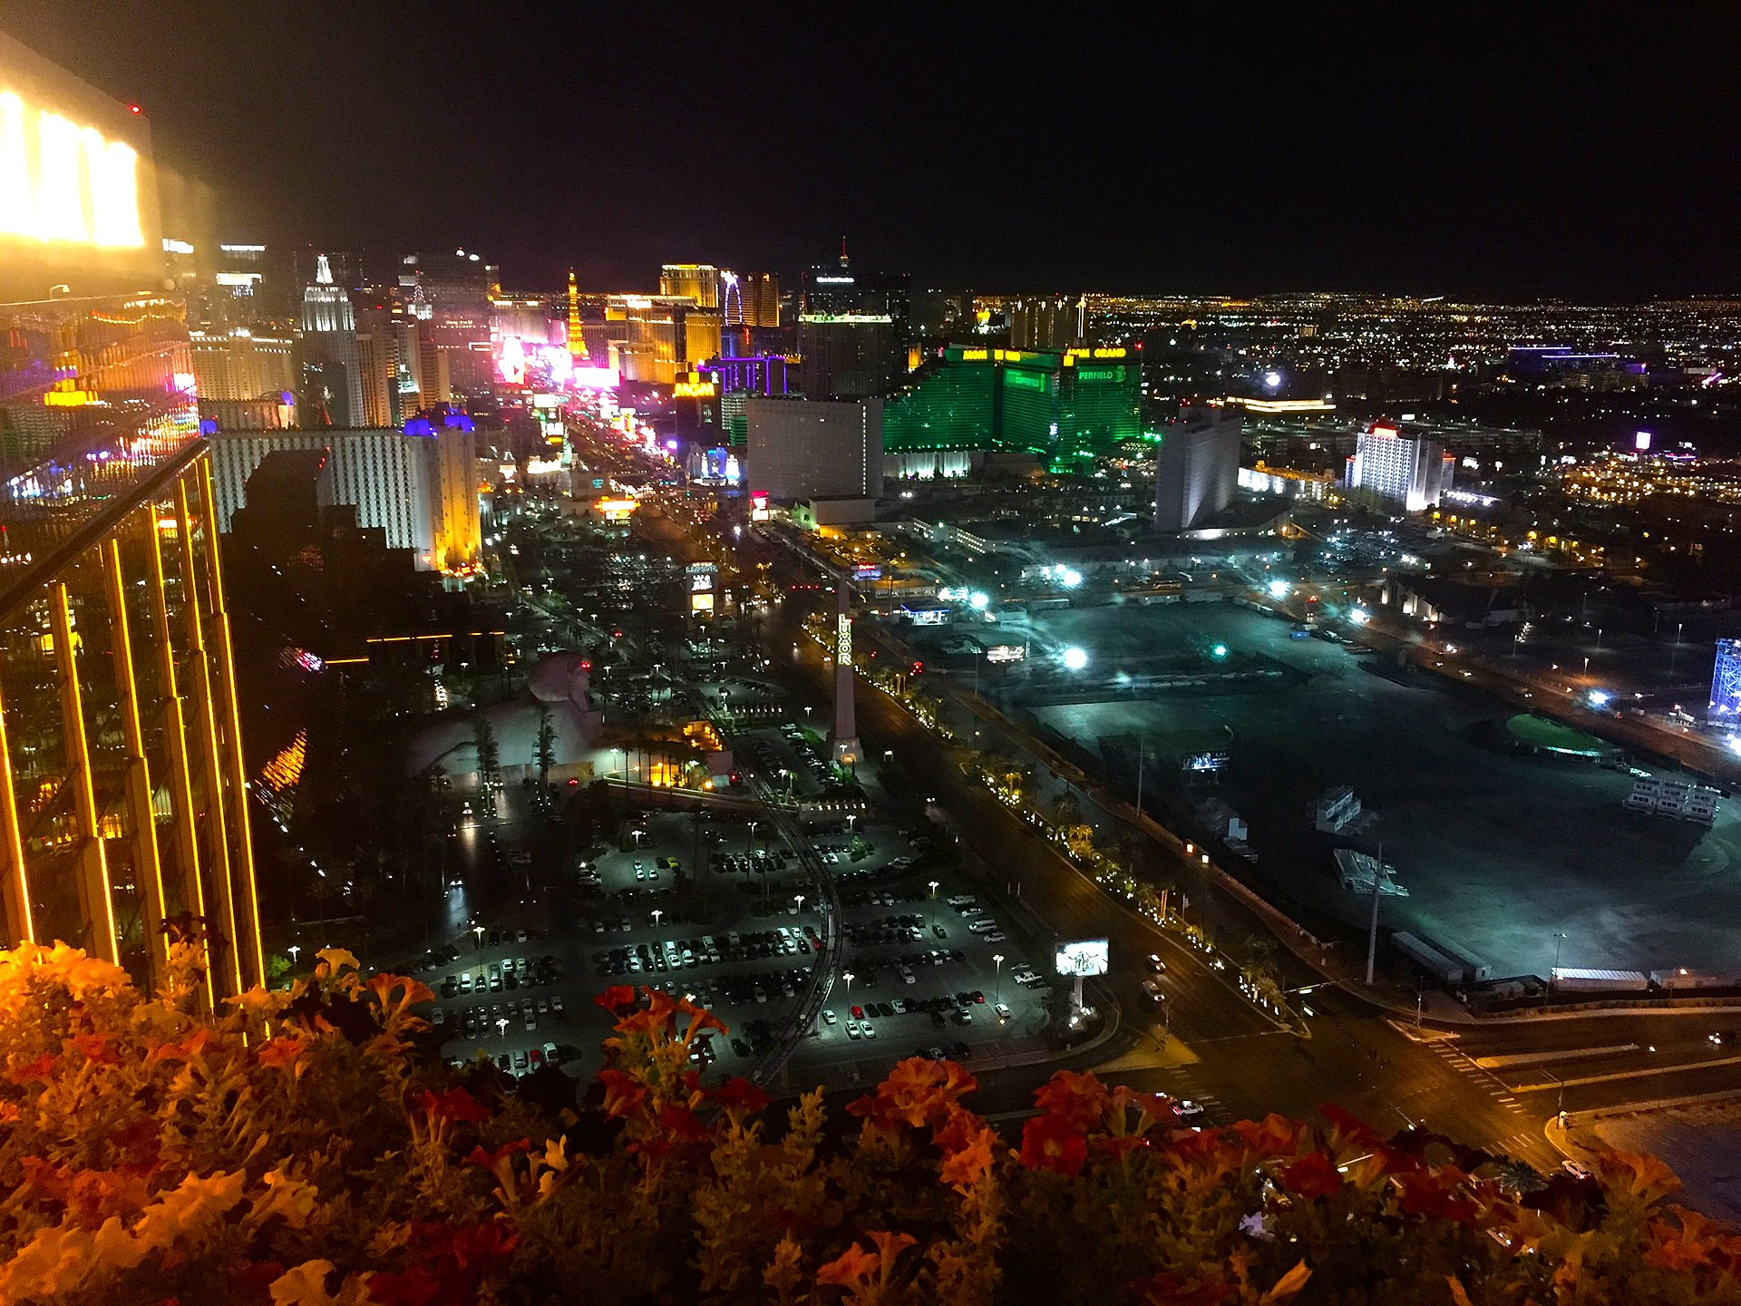
STEPHEN PADDOCK ROUTE 91 HARVEST FESTIVAL LAS VEGAS, NV 10-1-2017
Fired 1100 rounds of ammunition from the 32 floor of Mandalay Bay Hotel into the concert below
58 Dead and 422 Wounded. Weapons: 14 Rifles, Body Armor, Gas Mask
Professional gambler with $1.3 million in assets
Scouted at least 2 other locations
Committed suicide in room
Rationale:
Unknown

Slide 11
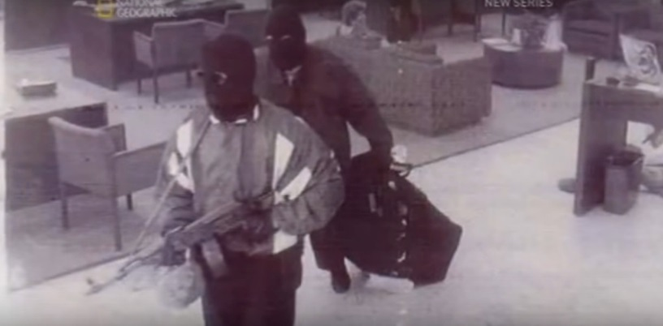
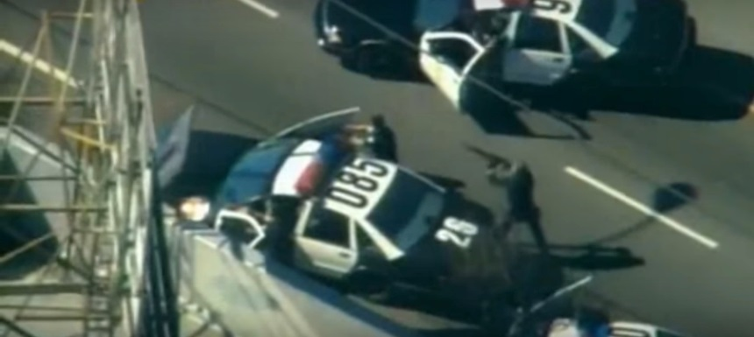
Larry Phillips/Emil Matasareanu Bank OF AMERICA Hollywood, CA 2-27-97
Career criminals
Committed multiple other bank robberies
13 Wounded:
9 PD & 4 bystanders
Weapons: AK-47s, HK91, M-16 and Body armor
Both suspects killed by LAPD SWAT after 44 minute gunfight
Failed robbery that changed law enforcement equipment

Slide 12
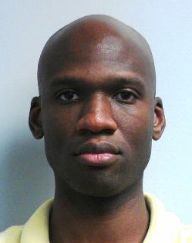
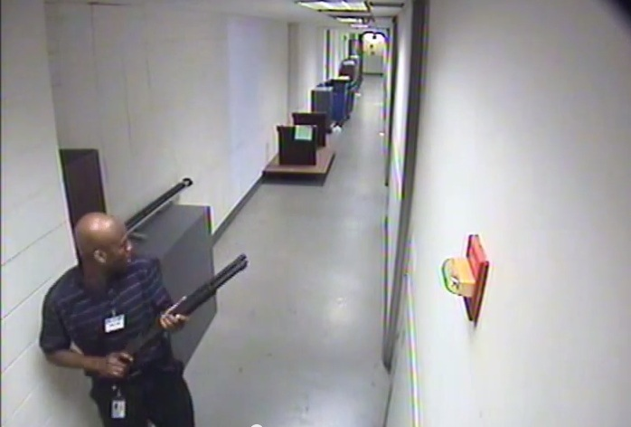
Aaron AlexiS WASHINGTON NAVY YARD WASHINGTON, DC 9-16-2013
Navy Vet and Govt Contractor
12 Dead and 3 Wounded.
Weapons: Remington 870 Shotgun and Beretta 9mm pistol
Killed in shootout with DC ERT and US Park Police officers
Rationale:
Felt he was underpaid and discriminated against by white people

Slide 13
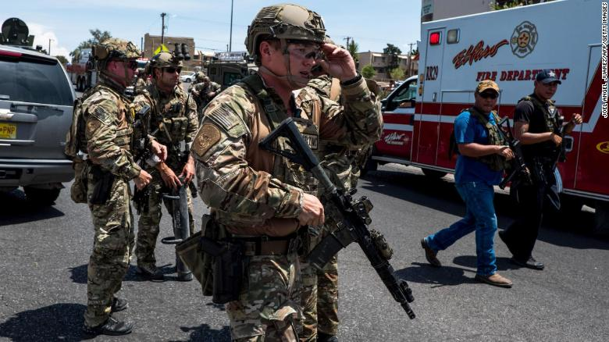
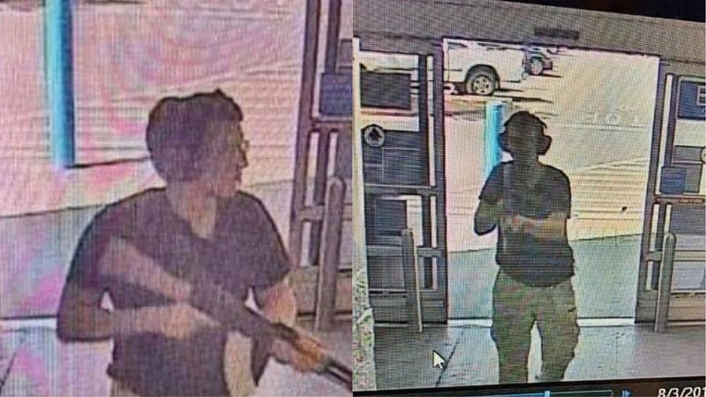
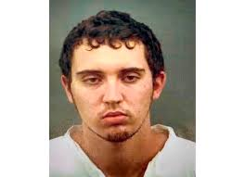
Patrick WOOD Crusius WALMART EL PASO, TX 8-3-2019
Self Identified White Nationalist
20 Dead and 26 Wounded. Targeted only Latinos and bypassed white and black customers
Weapons: AK-47 with armor piercing ammuntion
Surrendered to police
Rationale:
Fighting “Hispanic Invasion” and wanted to inspire similar attacks

Slide 14
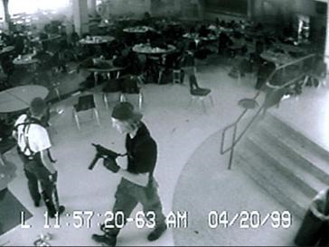
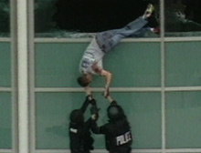
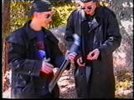
Eric Harris/Dylan Klebold Columbine High SCHOOL Littleton, CO 4-20-99
Harris-Psychopath (killer)
Klebold-Clinically depressed (suicidal)
13 Dead and 21 Wounded
Weapons: Tec 9, High point carbine, sawed off shotguns, and pipe bombs
Committed suicide
Changed the way law enforcement responds
Rationale
Angry teenagers attempted to kill as many students as possible after being bullied for years

Slide 15
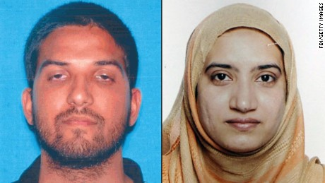
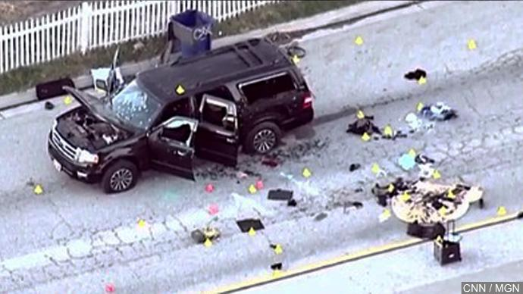
Syed Rizwan Farook/Tashfeen Malik INLAND REGIONAL CENTER SAN BERNADINO, CA 12-2-15
Married Couple of Pakistani descent. Wife was foreign national
14 Dead and 22 Wounded
Left their 6 month old daughter with grandparents before attack
Weapons: AR-15, and 9mm pistols which were bought by a neighbor in Corona, CA
Killed in shootout with police
Rationale
Radicalized via the internet in support of ISIS ideology. Believed in Jihadism and Martydom. No direct contact with terrorist organizations

Slide 16
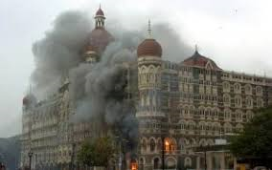
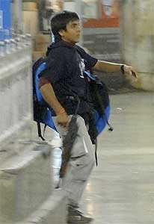
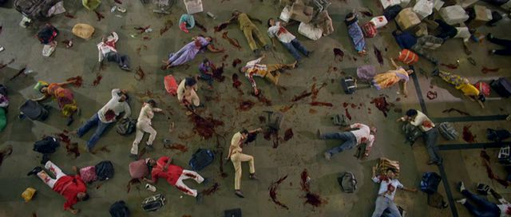
Lakshar E TAIBa Multiple Locations Mumbia, INDIA 4-16-2007
Planned and trained for a year, had steroids and amphetamines in their systems
10 attackers in split into 4 elements
Attacked 10 targets over 3 days. Started fires and left explosives as the moved from location to location
164 Dead, 308 Wounded
Weapons: Assorted Small Arms, Grenades, and explosives
All but one killed by Indian NSG & MARCOS during the battle
Rationale:
Religiously motivated terrorist attack

Slide 17
Prevention & Detection of Active Shooter Events
Harden the target (security upgrades)
Video surveillance of open areas
Peep holes on doors
Emergency lighting
Report suspicious activity to police and your administration
Implement an anonymous reporting system
Consider a multi-disciplinary team to assess potential threats
Train and prepare!
Identify an escape route
A survivor mindset is critical

Slide 18
Red Flag Indicators
Although no single set of warning signs are reliable predictors of an Active Shooter, there can be “red flags”.
A “red flag” indicator is a questionable, suspicious or inappropriate behavior that may be presented through someone’s appearance, spoken or written words, or specific actions.

Slide 19
Examples of Red Flag indicators:
Behaviors which regularly interfere with working environment
Overly aggressive behavior or threats toward others
Poor decision-making and coping skills
Low frustration tolerance; overreaction to circumstances; anger management problems
Notable change in behavior or appearance
Writings, comments or social network postings endorsing violence; an unusual interest in violence

Slide 20
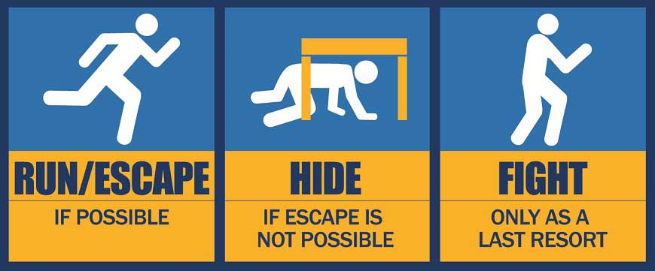
Surviving an Active Shooter
Notes:
Use of the term “DEFEND” can be addressed in slide #22

Slide 21
RUN = Evacuate
Decide if you can escape safely
If it is safe, run as fast as you can away from the direction of the gunshots
DO NOT stop running until you are far away from the area
Leave your belongings behind
Help others escape, if possible
Prevent individuals from entering the area, but not at the risk of your own safety

Slide 22
RUN (other considerations)
Get away from the threat and identify a safe place
When fleeing from danger, keep buildings, cars or other objects between you and the threat
Do not attempt to move wounded people
Call 911 when safe

Slide 23
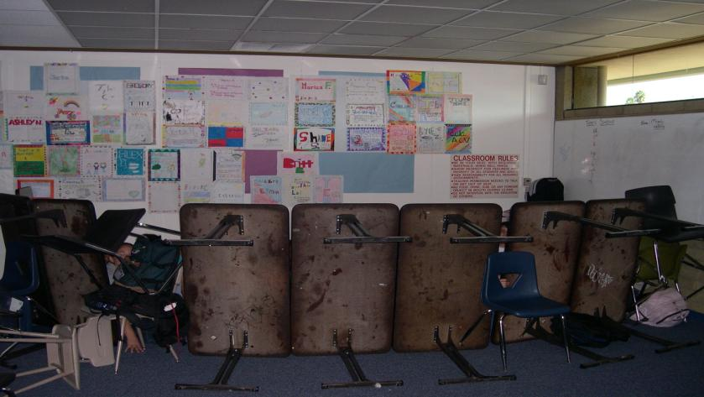
HIDE = Lockdown
If escape is not feasible; hide and create a stronghold
Lock the door, turn off the lights and close the blinds
Take cover behind large items
Silence your cell phones and turn off vibrate mode
Remain quiet
Move away from doors and windows

Slide 24
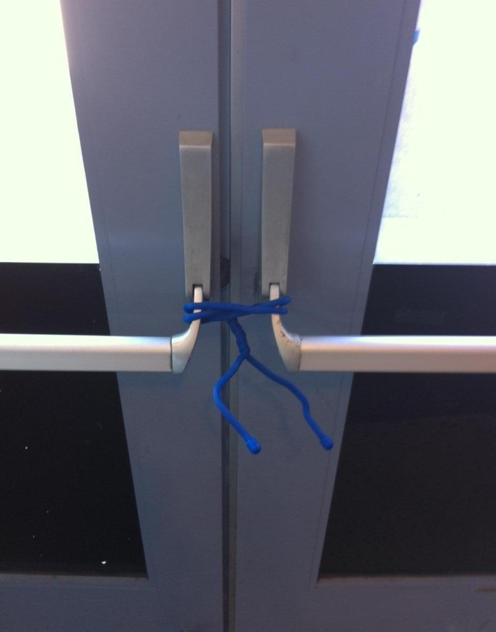
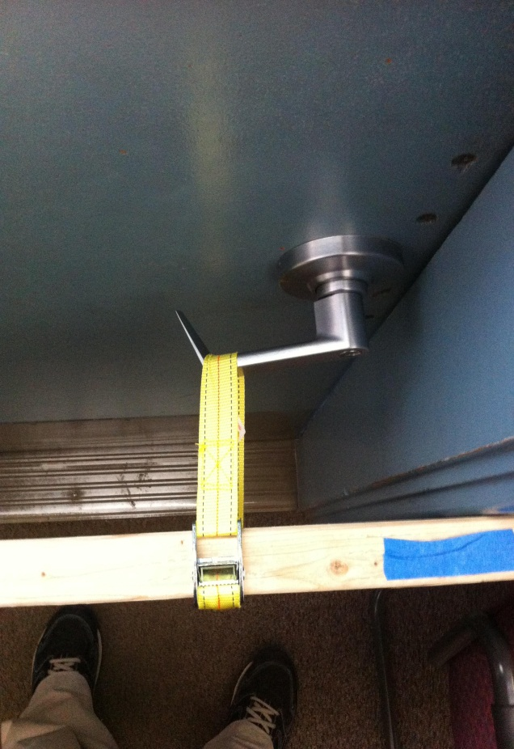
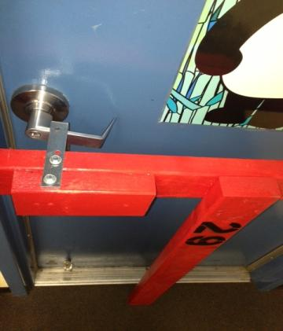
Reinforce the locked doors with chairs, desks, and other items

Slide 25
Erect barricades on ALL doors
Fill in the voids
Suspect will take the Path of Least Resistance

Slide 26
Good example of a barricade
Reinforce the primary barricade

Slide 27
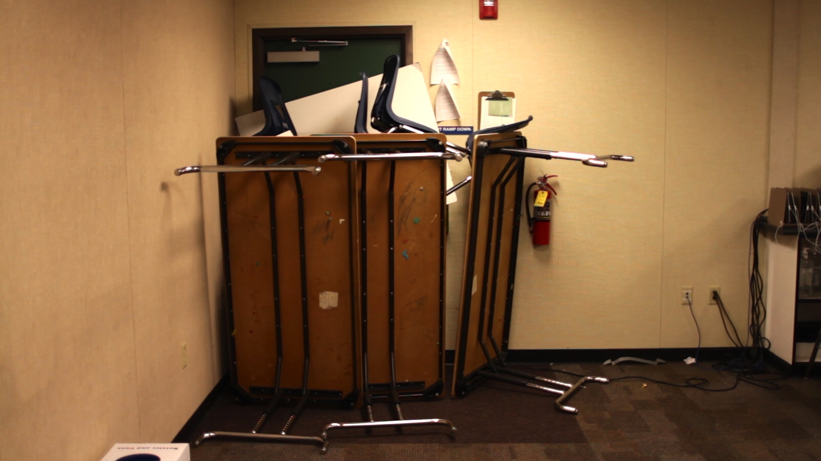

Slide 28
HIDE (other considerations)
Call 911 when it is safe to do so
Be prepared to provide what, who, where, when
Once you have secured the door do not open it for anyone. Police will enter the room when the situation is over.
Prepare yourself mentally and physically for the possibility of engaging the shooter
Put yourself in a position to surprise the suspect(s) if they enter the room.

Slide 29
FIGHT= Fight for your Life
This is a last resort
Commit to your actions!
Act as aggressively as possible
Improvise weapons (Fire extinguisher/Office Equipment
Attack in a group
Yell and make loud noises to disorient the shooter
If possible, grab the shooter’s limbs and head, take them to the ground and hold them there.
Notes:
Clarify the term “DEFEND” as opposed to “FIGHT”. Data shows that taking some kind of action to defend your life or the lives of your students significantly increases the chance of survival.

Slide 30
Things to Consider Before Fighting Back
Chance of survival may be greater if you incapacitate the shooter but consider:
How many shooters are there?
How many of you are there?
How many of you will commit to an attack?
What objects do you have available to disable the person?
Do any of you have military training or experience handling firearms?
Does the group have a plan?
Are your odds good?

Slide 31
When Your Decision is to Fight
Never attempt to wrestle a gun away from someone pointing it at you
The closer you are to the shooter the better the chances of overcoming them chance of survival is greater when you
are behind or out of vision of shooter
incapacitate the shooter
improvise a weapon
throw heavy, blunt or sharp object
hit shooter with something heavy (fire extinguisher)
use cart to shove them down or door open
jump on them
stab them with letter opener, scissors, etc.
Try to knock them down & then pile on them
Go for hands, eyes, neck, personals
You must COMMIT 100%

Slide 32
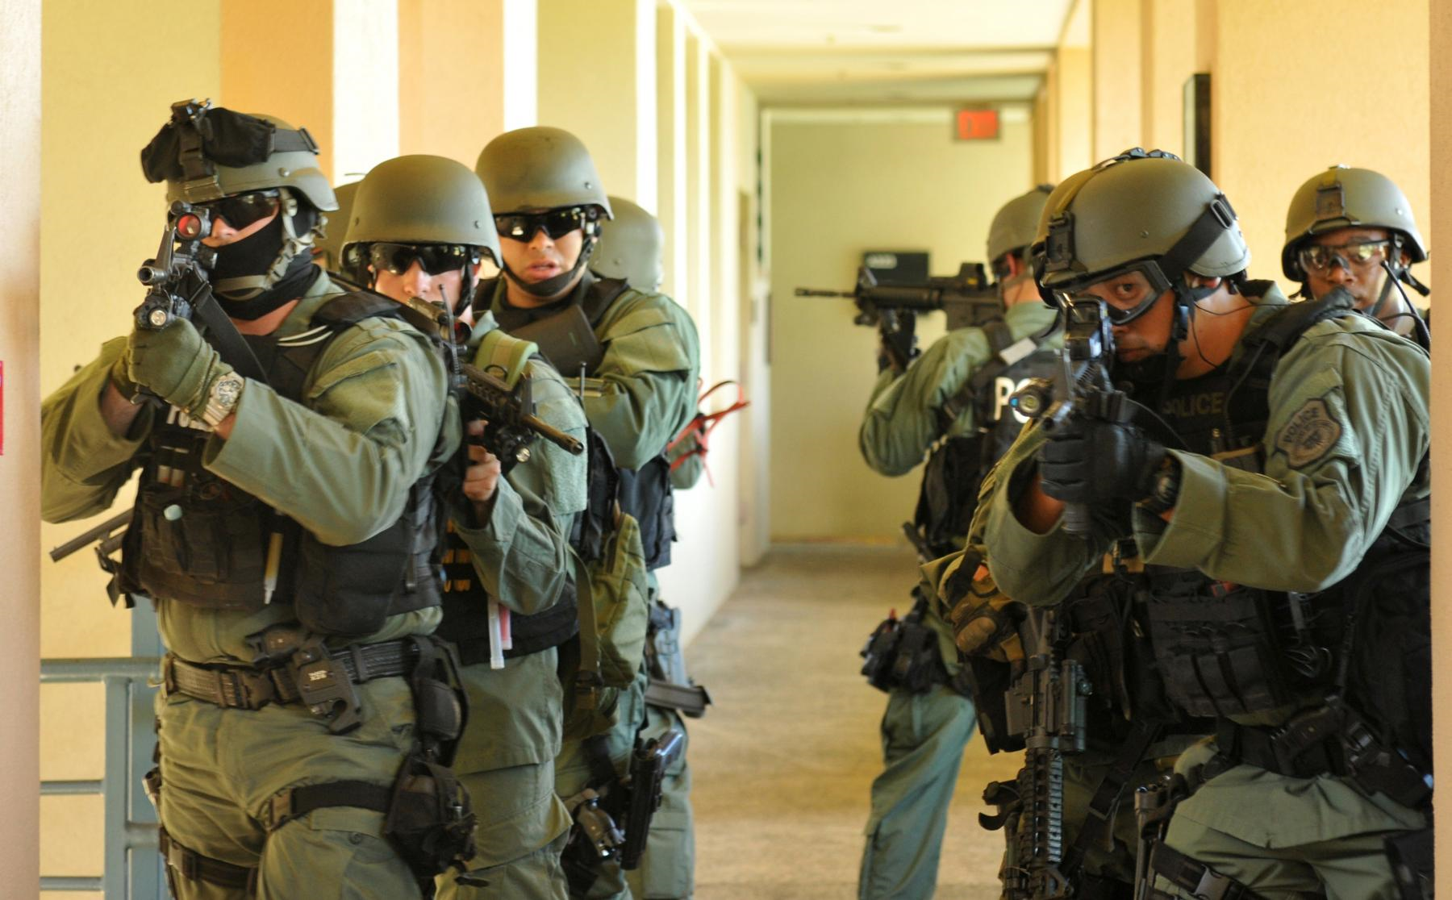
Police Response
Their first priority is to eliminate the threat
Officers will advance to the area where the last shots were heard
Initial officers will not tend to injured victims nor stop to speak with you

Slide 33
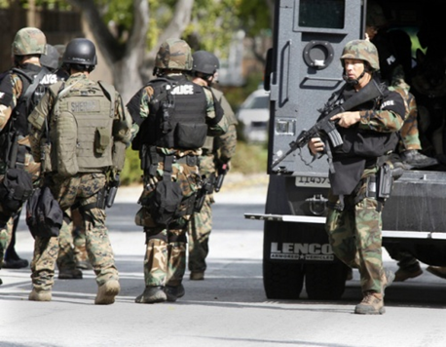
Additional Officers and Rescue Teams
Officers may not be wearing traditional police uniforms
Instead they may be in plain clothes or “tactical” gear with rifles, helmets and ballistic vests
To minimize risk, everyone must be treated as a suspect until the suspect is identified
Officers will issue loud commands and may get physical

Slide 34
Reacting to Law Enforcement
Remain calm
DO NOT approach officers
Follow all instructions by officers
Put down any items and DO NOT pick up any weapons
Raise hands, spread fingers, drop anything
Do not move injured victims
Avoid quick movements
Avoiding screaming or yelling at officers
Point in direction of the shooter
If you are barricaded in a room, DO NOT open door

Slide 35
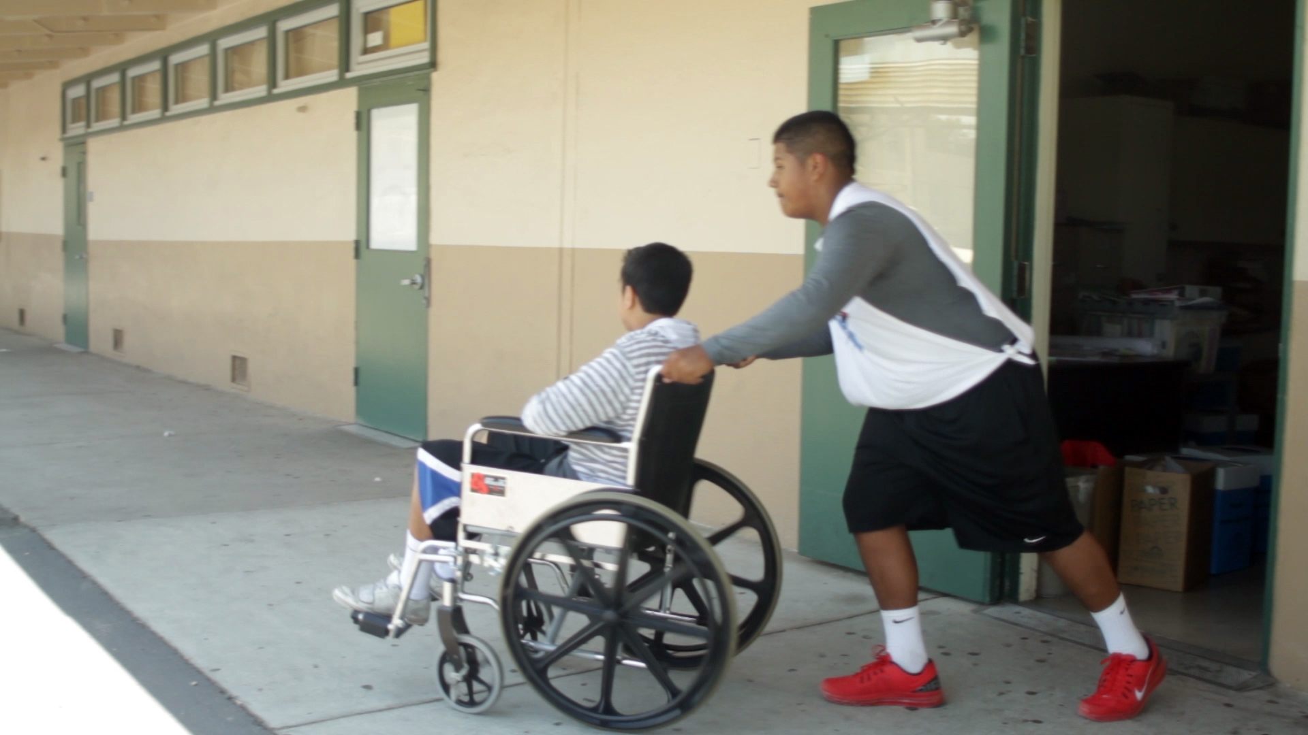
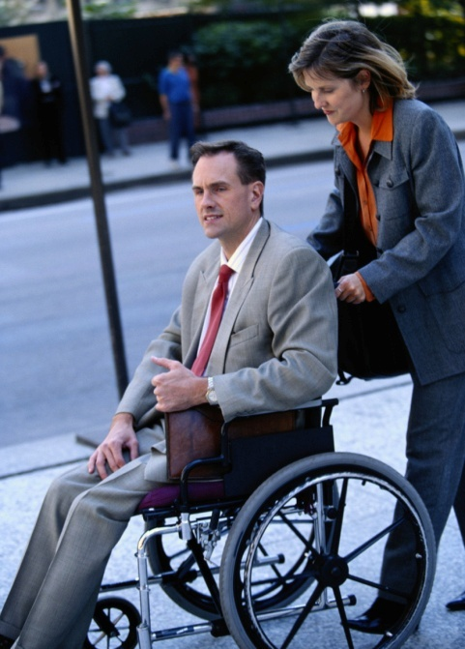
Other Considerations
Be aware there may be situations where people:
May have limited or no English proficiency
May be hearing or sight impaired
May be mobility impaired
Do the best you can to help without putting yourself at risk

Slide 36
Training Summary:
Plan & prepare ahead of time
Be aware of your environment
Always know your escape route
Your survival options in an Active Shooter Event: RUN, HIDE, FIGHT!
Call 911 when it is safe to do so
Never approach an officer during an active shooter situation

