Slide 1
The Inland Gateway AOR
Department of
Real Estate
Daniel Sandri
Acting Real Estate Commissioner,
Chief Deputy Commissioner

Slide 2
DRE Operations
Five District/Exam Offices
San Diego
Los Angeles
Fresno
Oakland
Sacramento
Authorized Positions: 354

Slide 3
100 Years of Real Estate Oversight
Realty Act of 1919 became law July 27, 1919.
Supreme Court ok’d law on November 29, 1919
Various manifestations of DRE over the century, but mostly DRE.

Slide 4
Information Technology Projects Completed
Subdivision Online Public Report Application System (SOPRAS) implemented September 2018
Broker-Associates on eLicensing- implemented on October 2018
New Virtual Call Center (VCC) System-implemented December 2018

Slide 5
Information Technology: Corporate Broker-Officer renewals added to eLicensing

Slide 6
Corporate Broker-Officer Renewals added to eLicensing
Broker-officers may use eLicensing to renew corporate broker-officer license
Corporation and broker-officer license must be in a “licensed” status to be able to renew on eLicensing
A broker-officer license must be renewed within 90 days of the expiration date of the broker-officer license to use eLicensing

Slide 7
Information Technology What’s Next:
Online submittal of exam and license applications-tentative date of December 2019
Second phase of Subdivision Online Public Report Application System (SOPRAS) - tentative early 2020

Slide 8
What Audits is Seeing
Delays in providing records
Lack of Broker oversight
Trust Fund Shortages on PM, BE audits
Falsification of bank records
Recordkeeping violations
Team name violations and First Point of Contact Violations

Slide 9
What Enforcement/Audits Is Seeing
Unlicensed people performing real estate activities
Lack of Broker Supervision and Salespersons Operating as a Real Estate Broker. Salespersons CANNOT conduct property management or sales business without broker oversight.
Complaints from licensees that their public license information has been used for fraudulent activities. If you believe your public license information is being used for fraudulent purposes, please contact the Department’s Enforcement section so that we can investigate.

Slide 10
What Enforcement/Audits Is Seeing
Use of “Team Names” and “Mega Teams”
“Virtual” Real Estate Brokerages
On-line companies that offer quick-sale services; offer to purchase homes using computer algorithms; and send cash offers to motivated sellers within a few of days.

Slide 11
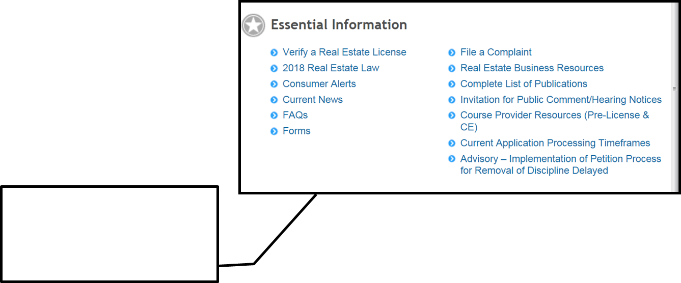
Resources For Business on DRE Website

Slide 12
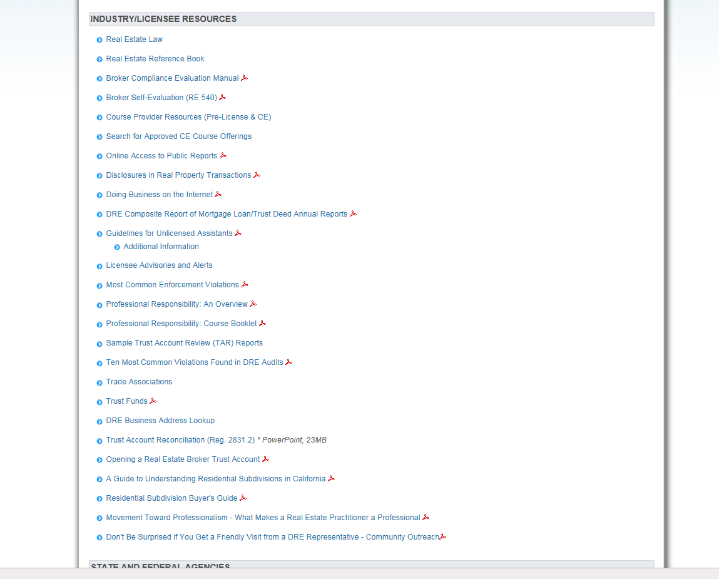
Real Estate Business Resources

Slide 13
Recent Regulations
● First Point of Contact
● Removal of Discipline from DRE’s Website

Slide 14
First Point of Contact
● AB 1650 (Frazer)
● Regulations completed
◦ Effective Date: March 28, 2019
◦ License number required on “1st Point of Contact” solicitation materials
◦ Responsible broker’s number not required as long as responsible broker’s name/logo appears with name and license number of salesperson or broker associate

Slide 15
First Point of Contact (Continued)
● 1st Point of Contact
◦ Business Cards
◦ Stationery
◦ Websites owned or controlled by the soliciting licensee
◦ Promotional and advertising flyers, brochures, leaflets, etc.
◦ Advertisements in electronic media (internet, e-mail, radio, television, etc.)
◦ Print advertising in any newspaper or periodical
● Excludes “for sale”, “for rent” or “open house” sign where sign has no name/logo or the name/logo belongs to the responsible broker

Slide 16
Petitions to Remove Discipline from Website
AB 2330 (Ridley-Thomas)
● Prior law required DRE to post status of every license on its website
◦ Including all discipline
● New law authorizes the Commissioner to set up a petition process to remove discipline from the website
◦ Licensees only (not available to unlicensed or non- licensed)
◦ Discipline must be 10 years or older
◦ Petitioner must pay a fee set by regulation
◦ Findings that no credible risk to members of the public exists as a condition to removing discipline
● Effective Date: March 7, 2019

Slide 17
Team Names
Bus. & Prof. Code section 10159.7(a)(3):
“’Team name’ means a professional identity or brand name used by a salesperson . . . for the provision of real estate licensed services.”

Slide 18
Team Names
Used by two or more real estate licensees
The team name includes the surname of at least one licensee member of the team
The team name includes “associates,” “group,” or “team”
The team name does not include:
Real estate brokerage
Broker
Brokerage
Other term that leads a member of the public to believe that the team is offering real estate brokerage services
Other term that suggests or implies the existence of a real estate entity independent of a responsible broker

Slide 19
Advertising – Responsible Broker’s Identity
Salesperson-owned DBA’s
Advertising and solicitation materials using a fictitious business name shall include the responsible broker’s identity in a manner equally as prominent as the fictitious business name (Bus. & Prof. Code §10159.5(d))
Note: “Responsible Broker’s Identity” moved from section 10159.7 to section 10015.4
Team Names
The responsible broker’s identity shall be displayed as prominently and conspicuously as the team name in all advertising and solicitation materials (Bus. & Prof. Code §10159.6(b))

Slide 20
THANK YOU!

