Slide 1
WORKING WITH GLOBAL CLIENTLE
SPENCER HOO
hoo.global Consulting | RE/MAX Omega | Azura Holdings

Slide 2
Chair (2018-2019)
Orange County REALTORS
Global Business Alliance Committee
Vice-Chair (2019) Chair (2020)
California Association of REALTORS
Global Real Estate Forum

Slide 4
International
adjective
1. between or among nations; involving two or more nations
Global
adjective
1. pertaining to the whole world; worldwide; universal

Slide 5
Presentation Agenda
2019 Global Update
Cultural Etiquette and Differences
Tips to Stay Out of Trouble

Slide 9
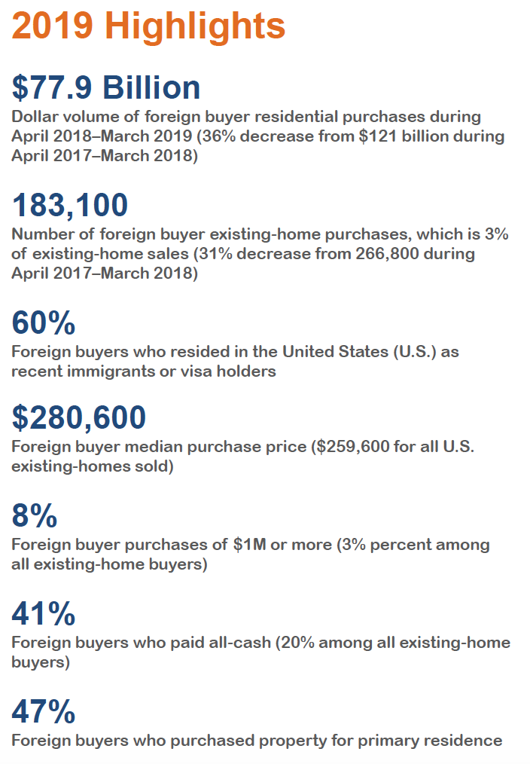

Slide 11
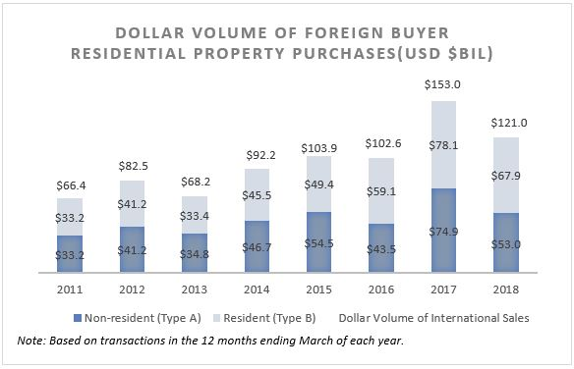

Slide 12
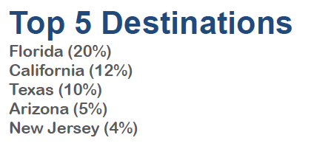

Slide 13
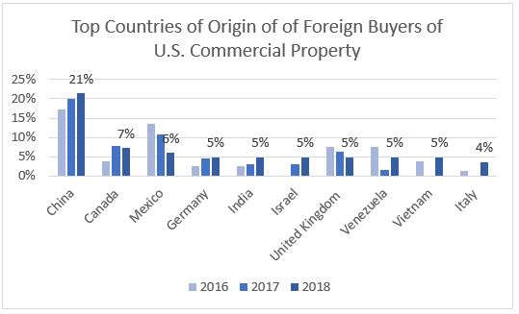

Slide 14
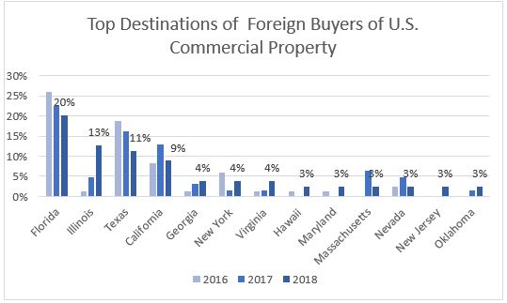

Slide 15
Cultural Etiquette and Differences

Slide 16
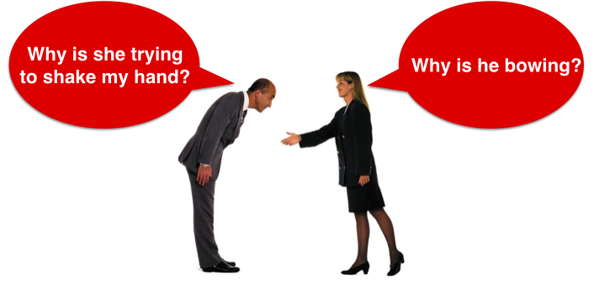
Meetings and Greetings

Slide 17
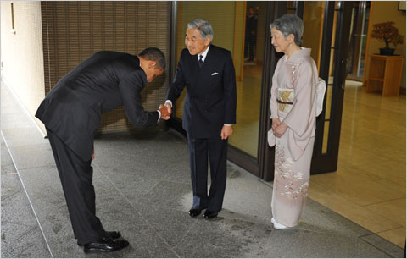

Slide 18
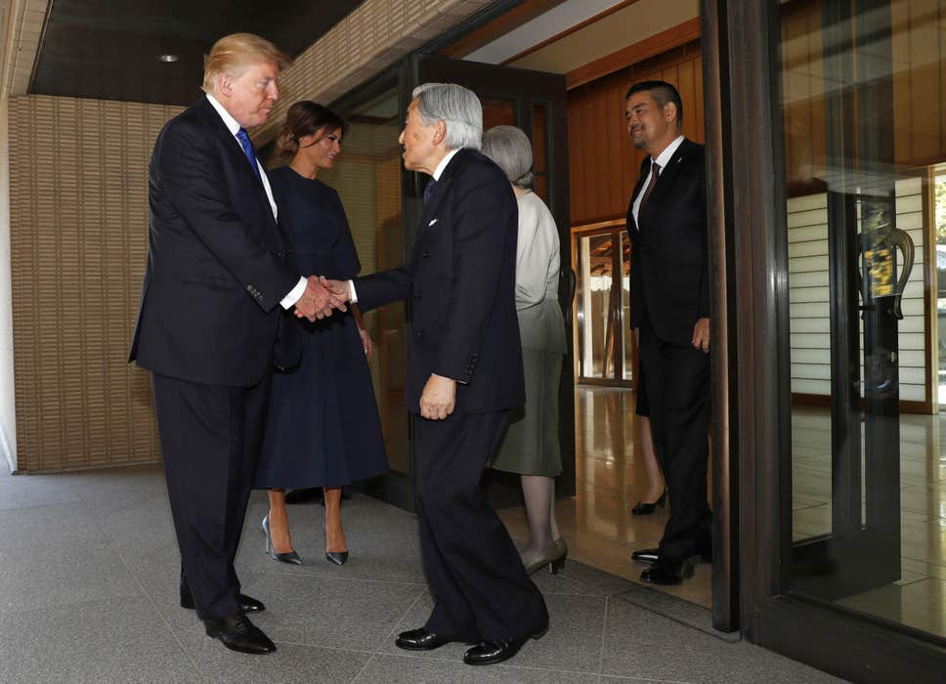

Slide 19
Presenting Your Business Card

Slide 28
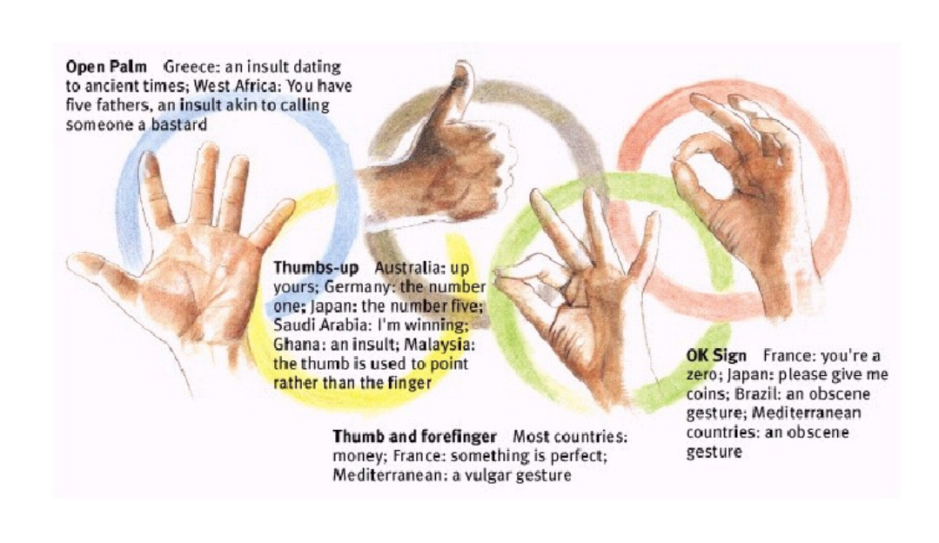

Slide 29
Tips to Stay Out of Trouble

Slide 31
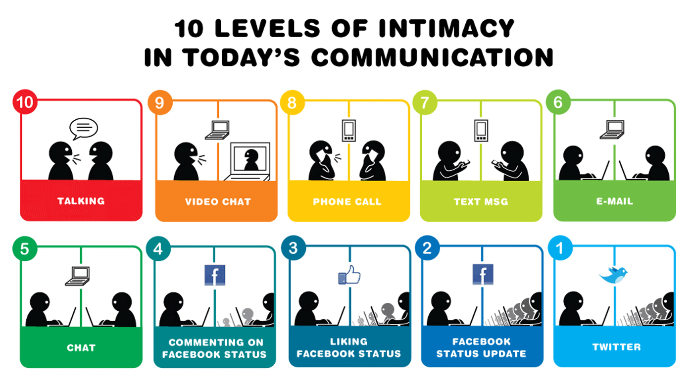

Slide 33
NO Tax or Legal Advice!!!

Slide 35
Title and Vesting

Slide 36
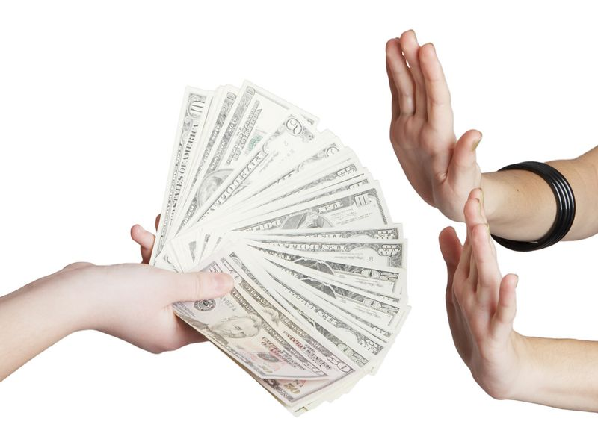

Slide 38
Questions?

