Slide 1
Branding on social media
Ads, content and focus
Hustlemediagroup.net

Slide 2
Intro
About Hustle Media Group
Brand Strategy
Content Creation
Posting
Driving Traffic
Q & A
What we’ll cover and who we are

Slide 3
HUSTLE MEDIA GROUP
ADVERTISING & PRODUCTION AGENCY

Slide 4
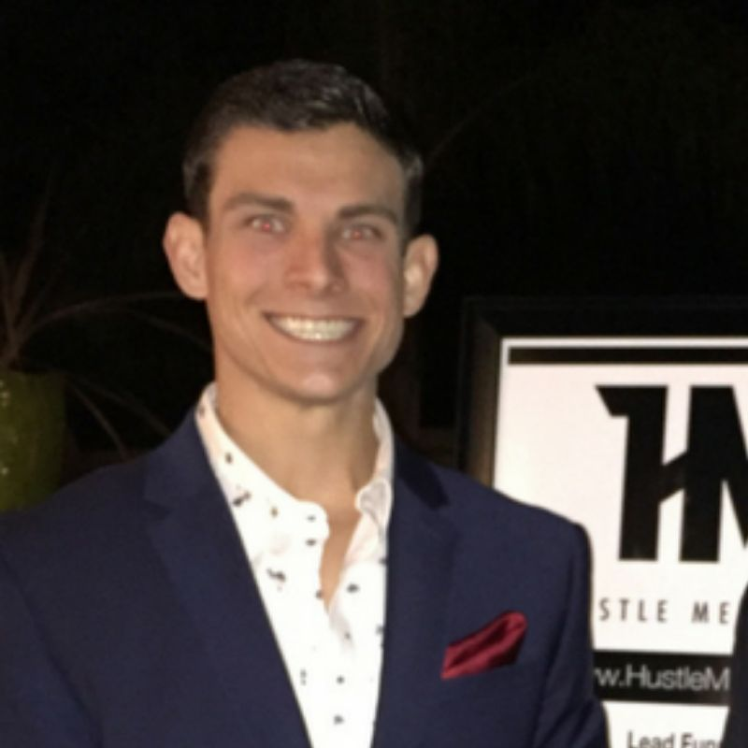
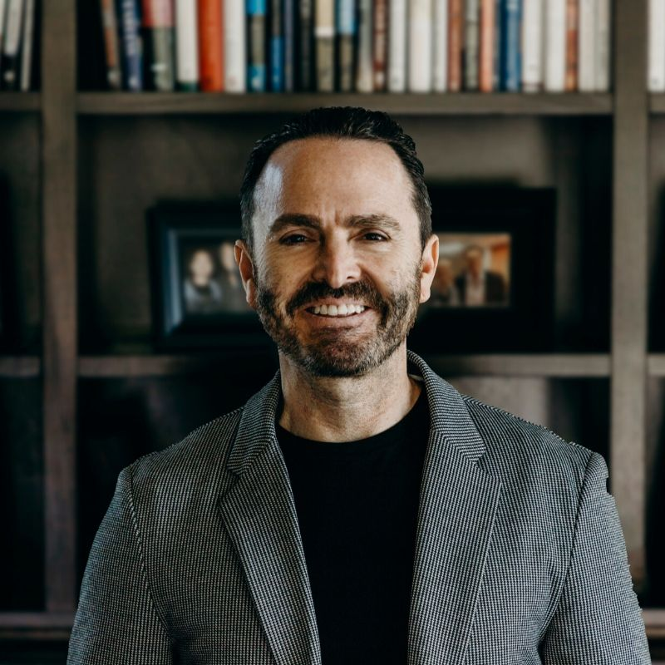
Meet the founders
Hustle media group
Jarett Richards
Conrad padilla
Jarett Richards is an entrepreneur who has always been very creative. He started design, production and other businesses in high school that eventually led to the creation of HMG and his other businesses. Jarett specializes in creative strategy, business development, system automation and uses creativity for opportunity.
Conrad Padilla started a career in his early twenties on Wall Street in New York with Dean Witter & Morgan Stanley. He helped these companies with mergers, acquisitions, investment banking and managed client and institutional money. Conrad uses his passion to help strategize for our clients brands and overall campaigns.

Slide 5
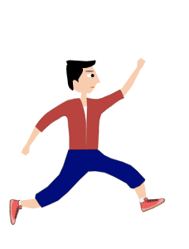
Be intentional
Having a clear focus
Vision
Goal
Planning
Teamwork
Brainstorm
Strategy
Analyze
Consistency
Implementation

Slide 6
THE CORE ROOT OF WHAT SOCIAL MEDIA IS AND WHY IT WORKS
WHAT SOCIAL MEDIA REALLY IS
FREE distribution
WORD OF MOUTH
YOUR BRANDS CANVAS
BUILDING A BRAND THROUGH CREATIVITY

Slide 7
YOUR “WHY” POWER
SHOULD BE THE FOCUS
THIS GETS YOUR AUDIENCE TO THINK EMOTIONALLY. THAT’S HOW WE CONNECT WITH THEM AND THAT’S WHEN PEOPLE USUALLY TAKE ACTION.
WHY DO YOU NEED THIS PRODUCT?
WHY I HELP MY CLIENTS?
WHY DID I WORK WITH …?
WHY I ….?

Slide 8
CONTENT CREATION
SELF-BRANDING LEADING WITH THE WHY

Slide 9
Create without fear
Paint your canvas
Videos
Photos
Film yourself talking about the market, addressing fears or big topics. You should do this in the social post, by going live and while showing homes. Each video should lead with the why and should showcase your personality.
Video is absolutely king, but platforms like canva.com are GREAT for easy content creation. Showcase a new listing or again, post about why you do what you do, tips or your two cents on various of topics.

Slide 10
Lead with the “WHY”
For valuable content
EXAMPLES:
Showcase your personality, use videos and canva.com to create visuals for the post. ALWAYS lead with the why.
6 Essential Home Buyer Tips
10 Mistakes To Avoid When Selling A Home
3 Main Things to know about the current market
Why this new listing is perfect for ……

Slide 11
We are currently using: later.com to automatically post
DISTRIBUTION
Facebook, Instagram
Twitter, Youtube, Blogs
Influencer Marketing
But are still engaging daily. Be sure to respond to comments!

Slide 12
Driving traffic
Advertising
Facebook & Instagram
Awareness: Use awareness ads to reach ideal audiences and grow recognition of who you are and what you do. Get creative and use detailed targeting to find home buyers or target home owners.
Retargeting: This is the KEY of social media. Retarget audiences who engaged with your videos or previous ads, went to your website, past emails and more!
Lead Generation: Use awareness ads to build “custom audiences” on Facebook Business Manager and retarget audiences for lead generation forms on Facebook and Instagram.
How: Create the ad, create the copy, create groups with detailed targeting and launch your ad with your pixel active on Facebook Business Manager.

Slide 13
Key Questions
Advertising
What’s your why power?
What are you selling and why would someone need it?
Who is your ideal audience?
What is your call to action? (CTA)
How can you tailor your ad content to your audiences?

Slide 14
Check list
Game plan for social marketing
Do I know my brand’s message, my why power and who I’m trying to target?
Do I know what CTA I can use and how to capture leads with a landing page or Facebook forms?
How am I going to create content for my brand?
Do I want to post manually or automatically? What is my schedule to focus on my social brand?
My goals for 2020 are….
My goals for 2022 are ….

Slide 15
Get Started
Social branding
1. Outline your game plan
2. Create content
3. Distribute the content
4. Advertise to ideal audiences
5. Stay consistent

Slide 16
Overview
Social Branding
If you want help completing these, please ask about our packages for:
Ad management
Content Creation
Focus:
Be Intentional and have a game plan.
Word of mouth and distribution using social media.
Creating content leading with the “why.”
Using ads and social media to drive traffic.

Slide 17
Hustle media group
hustlemediagroup.net
(888) 285-0525

